Slide 1
Using Oracy as a Pre-Writing Strategy
Saskia Fabricant
MATSOL Conference
May 7, 2015
9:30 – 10:15 AM

Slide 2
What is Oracy?
Oral language skills and structures necessary for a student to become literate in English
Relates to literacy objectives – not simply oral language
Academic listening and speaking

Slide 3
Why Oracy?
INT to HLD transfer process – SEI program to mainstream
Requirements of students in their mainstream classes:
MCAS
ELA required texts (e.g. Macbeth, The Odyssey, The Great Gatsby, Siddhartha, etc.)
ACCESS Scores at HLD:
Speaking: 4.30
Listening: 3.77
Reading: 3.27
Writing: 3.67

Slide 4
Three Strategies for Today
Informal Presentations (Outlines)
Formal Presentations
Debate
Other Strategies:
Academic Discussions – partners, groups, whole class
Other Types of Informal Presentations
Other Types of Formal Presentations

Slide 5
Informal Presentations (Outlines)
Teacher gives an academic prompt
E.g. “Do you agree with the author’s claim that the United States is becoming too materialistic?”
Students write claim as a group
4 corners or other method (by language ability, etc.) to group students
Students write three reasons with evidence to support their claim
Students share their work to the class to receive feedback
Students revise their outlines prior to writing

Slide 6
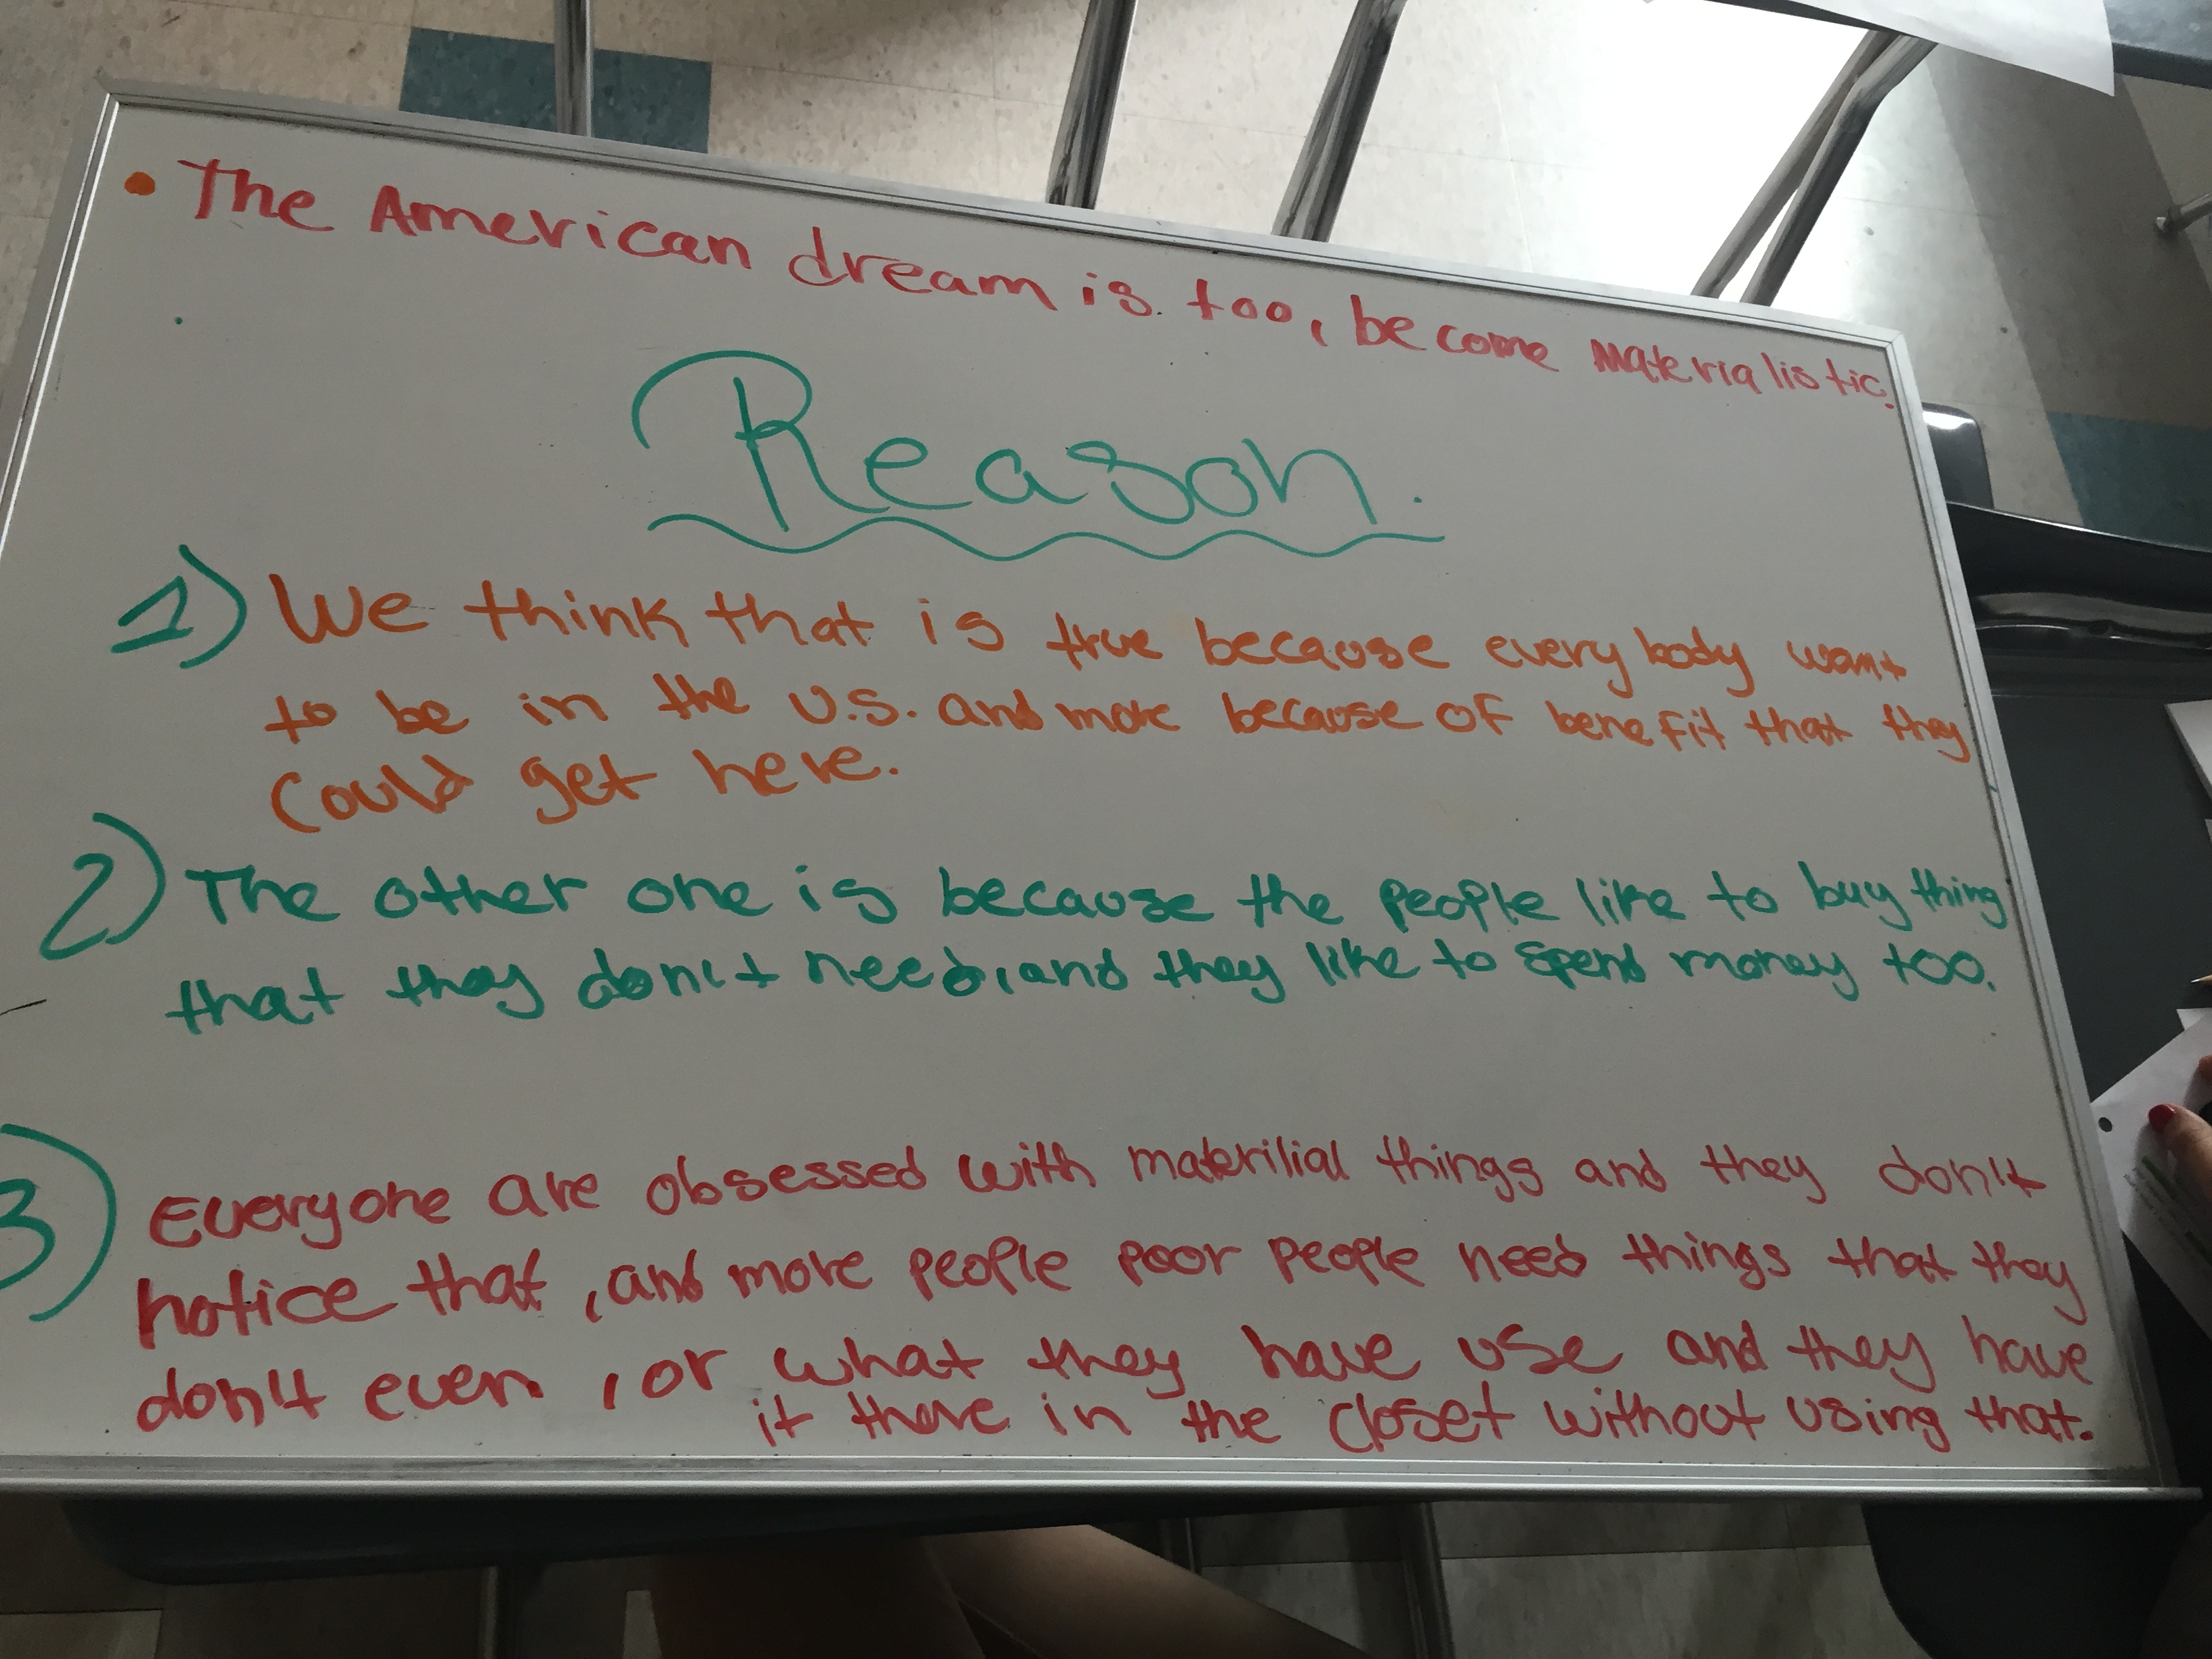
Informal Presentations (Outlines)

Slide 7
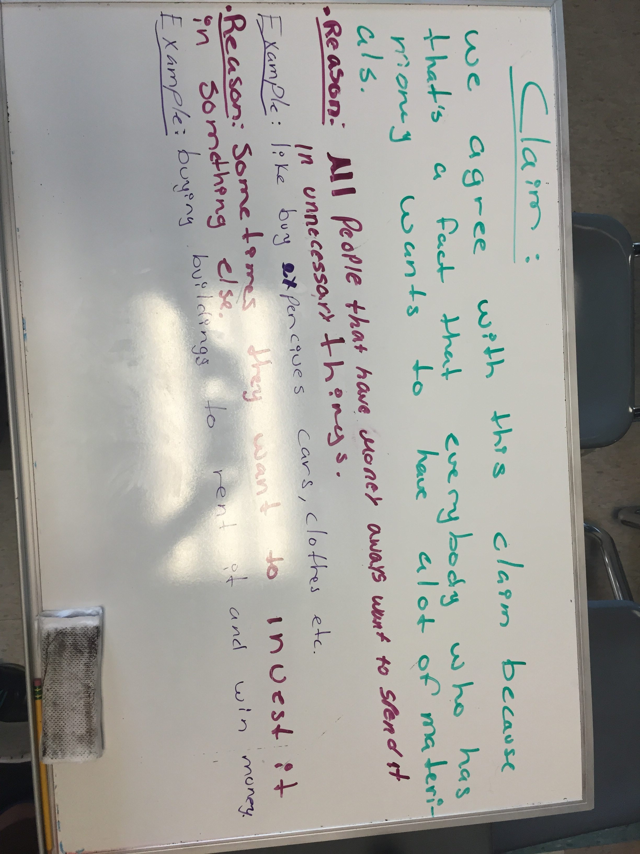
Informal Presentations (Outlines)

Slide 8
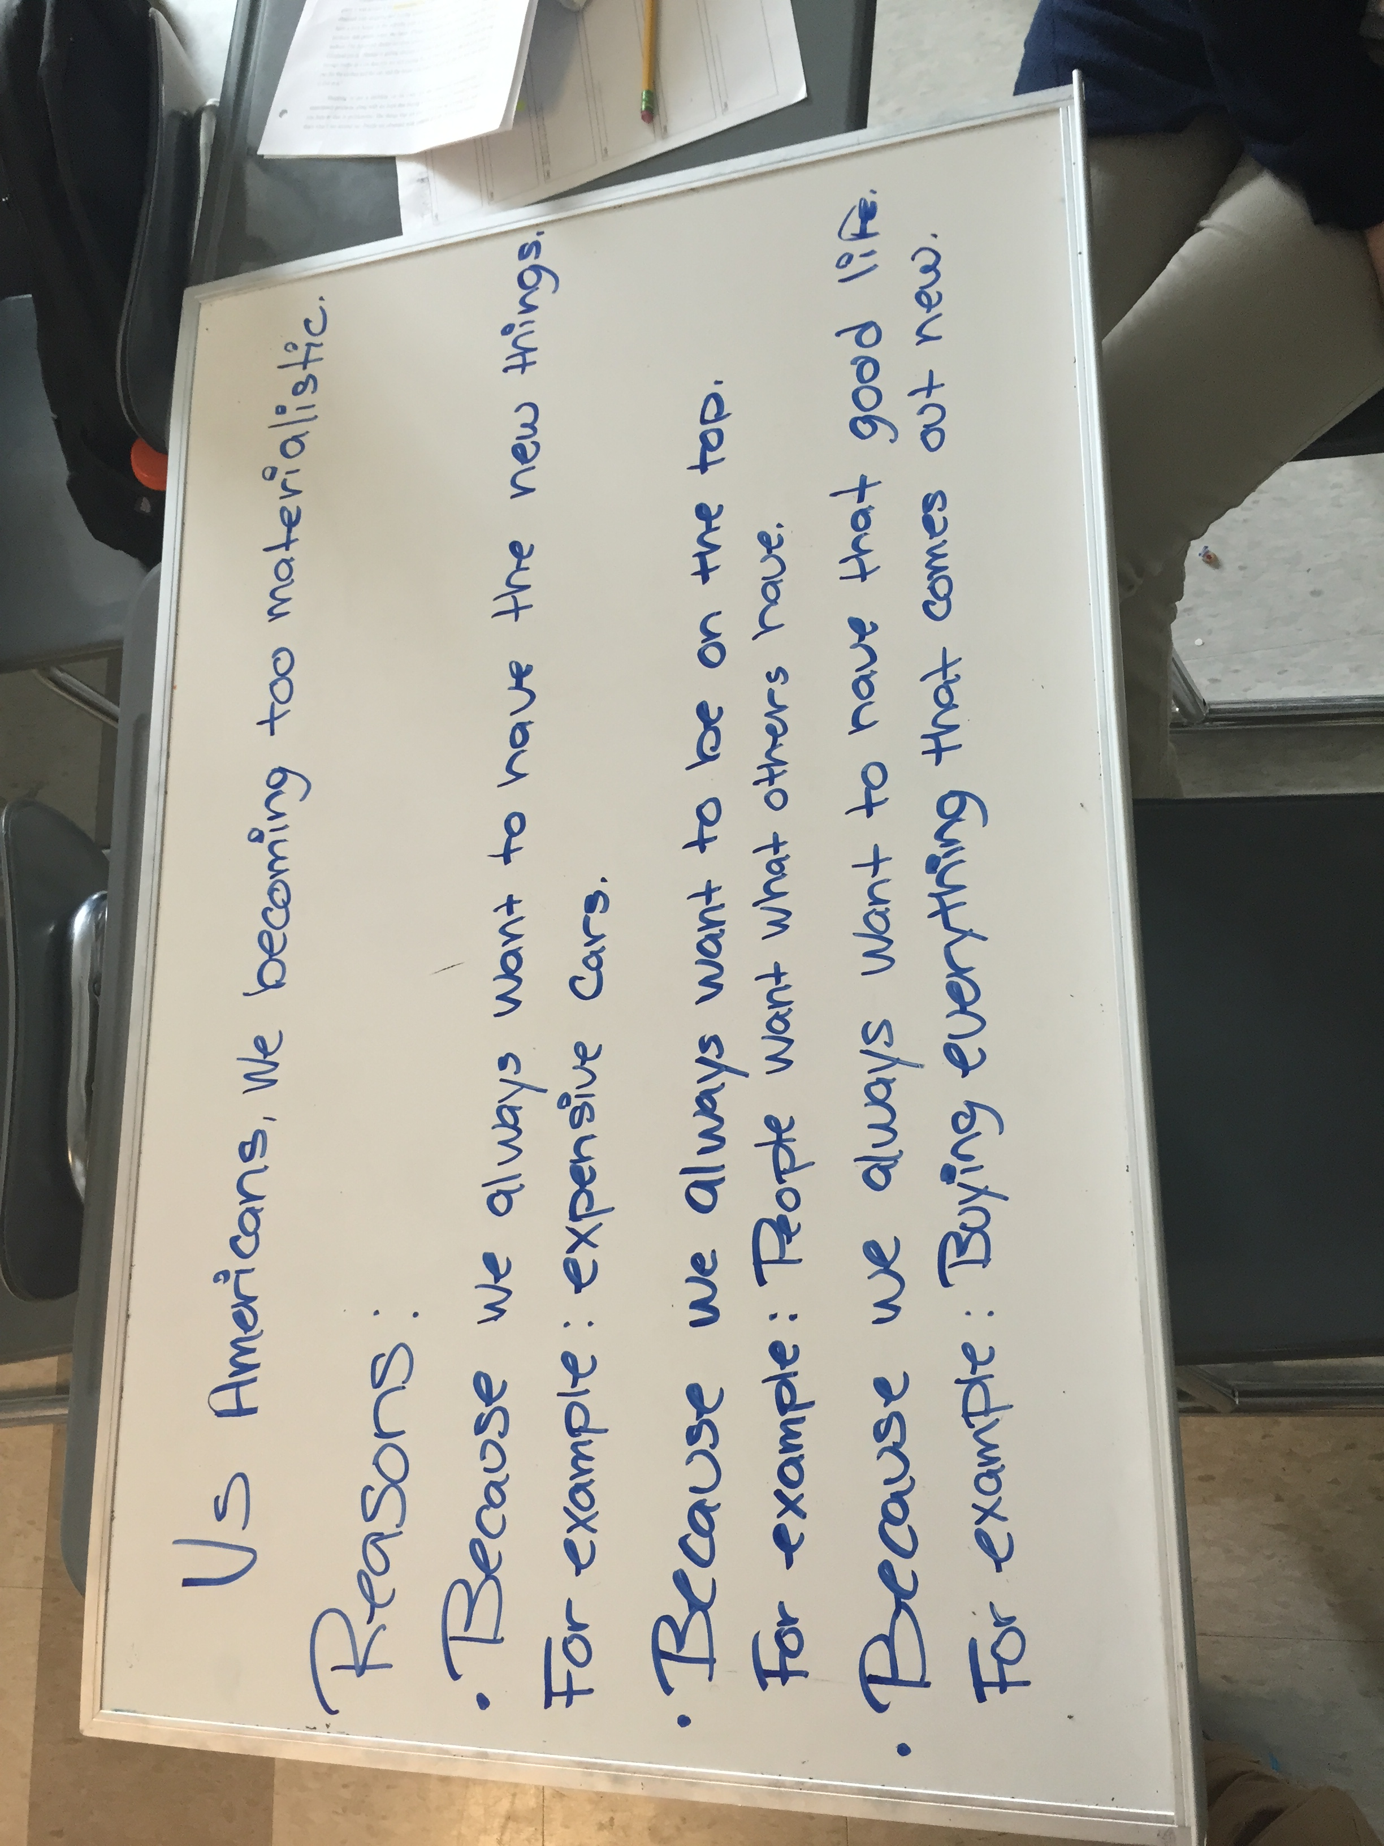
Informal Presentations (Outlines)

Slide 9
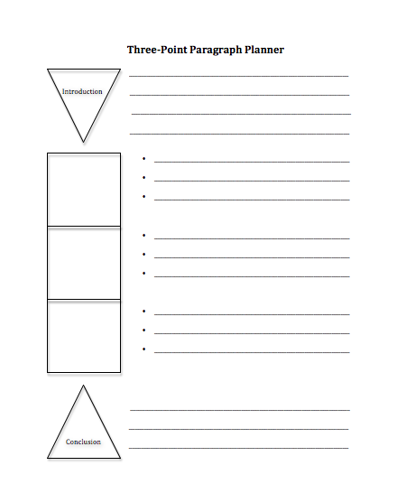
Informal Presentations (Outlines)

Slide 10
Formal Presentations
Teacher gives an academic prompt
E.g. “Describe Kino’s aspirations when he finds the ‘Pearl of the World.’ Explain what these ambitions tell us about him as a character.”
Students create a PowerPoint presentation
Side 1: Introduction – name, class, date, title, title and author of text
Slide 2: Thesis Statement
Slide 3: Topic Sentence 1, Two Quotes
Slide 4: Topic Sentence 2, Two Quotes
Slide 5: Topic Sentence 3, Two Quotes
Slide 6: Conclusion
Let’s look at some student work!

Slide 11
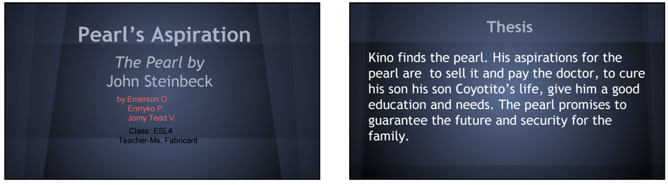
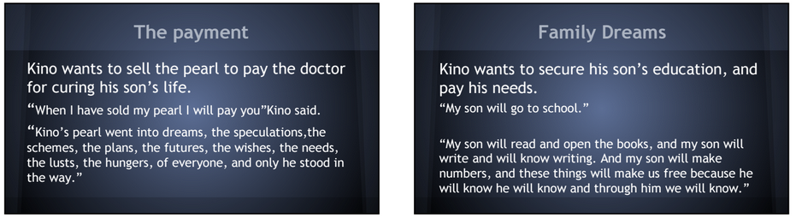
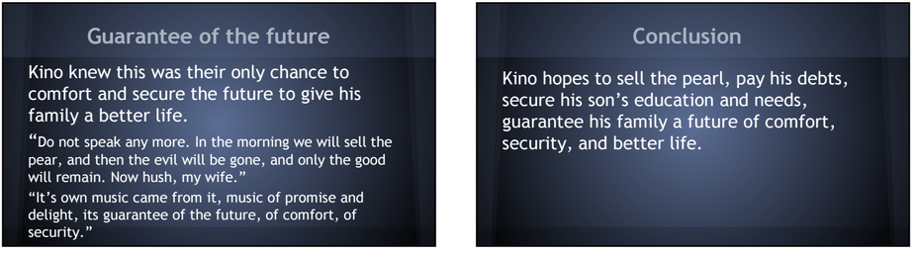
Formal Presentations

Slide 12
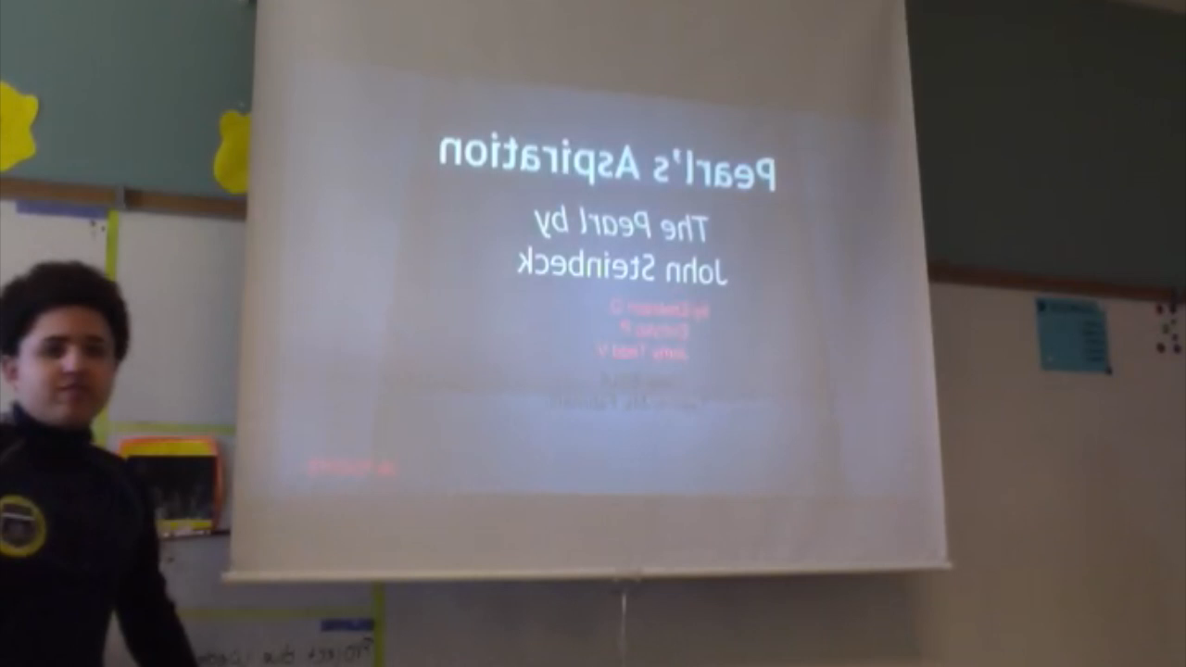
Formal Presentations

Slide 13
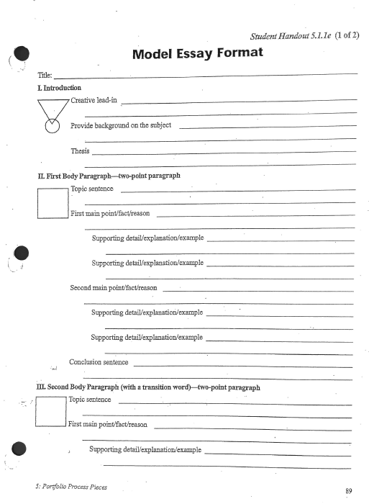
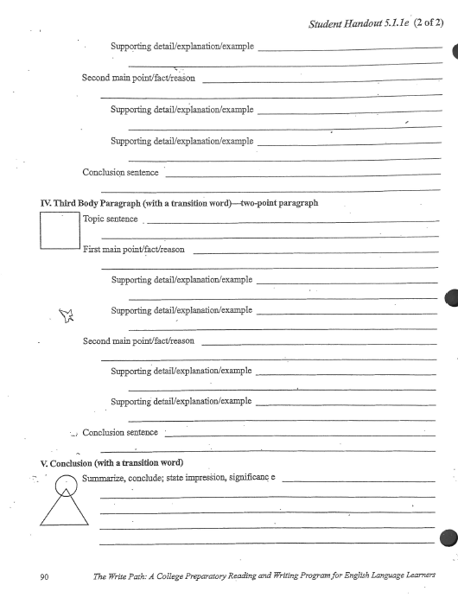
Formal Presentations
Writing Outline

Slide 14
Debate
Summative Assessment
Teacher gives academic prompt
E.g. “Should prisoners be afforded the basic human rights as outlined in the United Nations Declaration of Human Rights?”
Grouping students – 2 sides (Can do 3 or even 4 sided debate)
Four Corners, Position Line, etc.
Debate Preparation – Outline, prepare opening statement
Debate in class with notes
Check out bostondebate.org for more resources!

Slide 15
Debate
Debate Format:
Opening statements [2 minutes each]
Preparation [1 minute total]
Cross examination [1 minute each]
Preparation [1 minute total]
Cross-Examinee [1 minute each]
Preparation [2 minutes total]
Attack [1 minute each]
Preparation [2 minutes total]
Defense [1 minute each]
Preparation [2 minutes]
Closing statements [1 minute each]

Slide 16
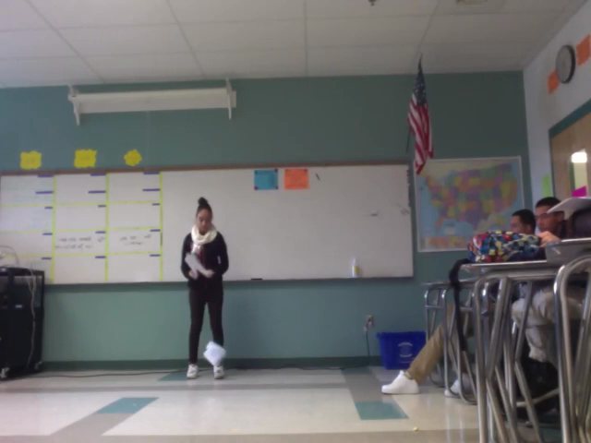
Debate
Opening Statement

Slide 17
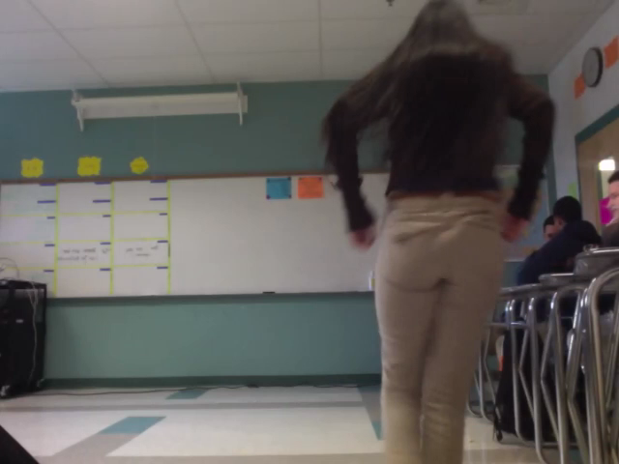
Debate
Preparation

Slide 18
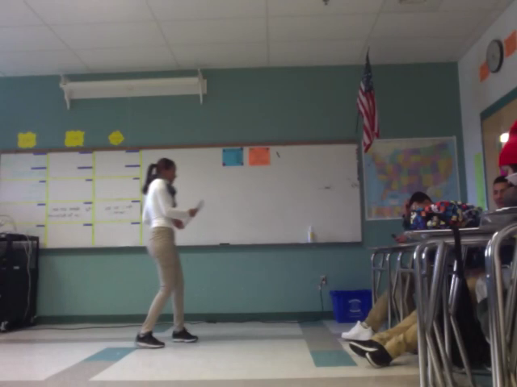
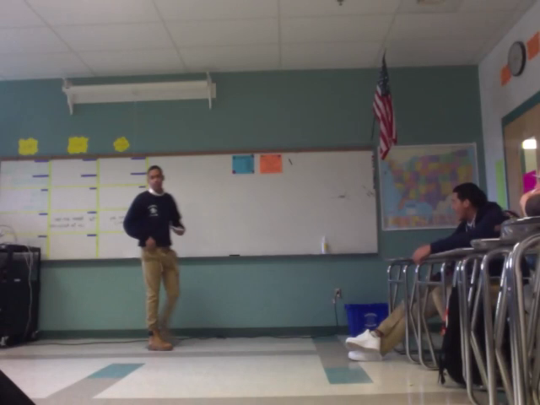
Debate
Cross Examiner and Cross Examinee

Slide 19
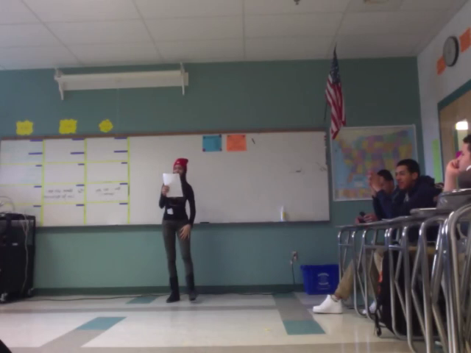
Debate
Attack and Defense

Slide 20
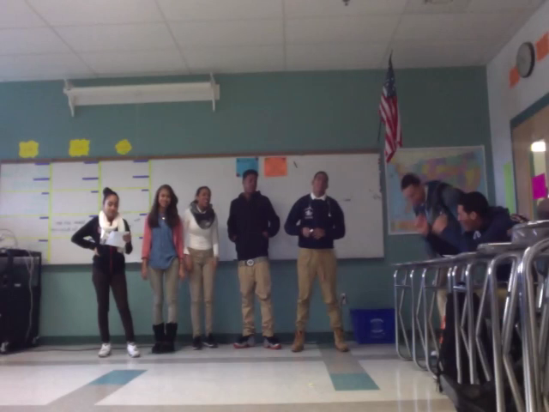
Debate
Closing Statement

Slide 21
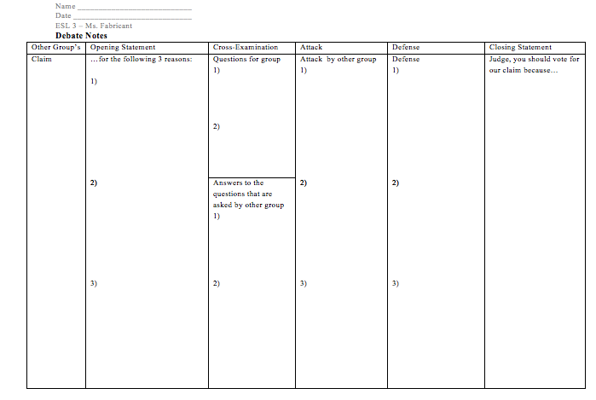
Debate

Slide 22
The Results
Improved writing ability on WIDA rubric → ACCESS scores
Enthusiasm for presentations and writing
Greater rates of completed work (97% up from approximately 81% last year)

Slide 23
Questions?
Saskia Fabricant
ESL Teacher, Humanities and Leadership Development High School in Lawrence, MA
saskia.fabricant@gmail.com

