Slide 1


Cutting-Edge and relevant teaching, not testing, of listening and speaking
Jennifer Lacroix Marnie Reed
lacroixj@bu.edu tesol@bu.edu

Slide 2
MATSOL Abstract
Effect of semester-long Pronunciation Instruction:
Metacognitive level - Learner beliefs
Procedural level – Learner Receptive and Productive Skills
Metacognitive Strategy Approach:
Training in Connected Speech, Stress and Intonation
increased Speaking and Listening Comprehension for utterance content and speaker intent
Area of Investigation
Pedagogic Approach

Slide 3
Learner-identified Listening Difficulties:
1. Recognizing known words in rapid speech
Development of word segmentation is a major challenge 
Vandergrift, L. & Goh, C. (2012) Teaching and Learning Second Language Listening: Metacognition in Action. NY: Routledge, p. 24.
as reported by researchers:

Slide 4
Requires Sentence Parsing Skills
P/S/L Topics for Communicated Content:
Phonotactics – permissible phoneme combinations
Connected Speech Features
Segmentals
Weber, A. & Cutler, A. (2006). First-language phonotactics in second-language listening. Journal of the Acoustical Society of America, 119(1). 597-607.
Al-jasser, F. (2008). The effect of teaching English phonotactics on the lexical segmentation of English as a foreign language. System, 36, 94-106.

Slide 5
Learner-identified Listening Difficulties:
2. Understanding the Pragmatic Functions of Intonation
understanding “the words but not the message” 
Vandergrift, L. & Goh, C. (2012) Teaching and Learning Second Language Listening: Metacognition in Action. NY: Routledge, p. 22.
as reported by learners:

Slide 6
Requires Sentence Inference Skills
P/S/L Topics for Communicative Intent:*
Discourse Knowledge
Prosodic Knowledge
Contrastive Stress and Intonation
*Rose, K. , Kasper, G. (Eds.). (2001). Pragmatics in language teaching. Cambridge: Cambridge University Press.

Slide 7
Instructional Approach
Teach the Processing of Aural Input --
“Much of what is traditionally mis-named teaching listening should in fact be called testing listening.”*
*Mendelsohn, D. (2006). Learning how to listen using learning strategies. In P. Gorden (Ed.), Current trends in the development and teaching of the four language skills. Mouton deGruyter, pp. 75-89.
as opposed to:

Slide 8
Instructional Approach
Teach the Processing of Aural Input --
-- at the metacognitive level
-- at the skill level
~ sentence parsing
~ utterance inferencing

Slide 9
Instructional Approach
Address Metacognition
Learner Beliefs ⇒Listening Strategies*
“learner beliefs affect the range of language learning strategies employed. . .” (Nix & Tseng, p. 114)
* Nix, J-M. L., Tseng, W-T. (2014). Towards the measurement of EFL listening beliefs with item response theory methods. The International Journal of Listening, 28, p. 112-130
Notes:
TESTED THIS IN AN IEP

Slide 10
Study Design: Pre-instruction Diagnostics Post-instruction Summative Assessment
Establish Pre-instruction Baseline
Metacognition
Skills
Provide Instruction
Connected Speech
Contrastive Stress & Intonation
Assess Post-Instruction Performance
Metacognition
Skills
Measure Gains

Slide 11
Study Participants
• Pronunciation/Speaking/Listening (P/S/L) Elective Class
within an 8-level EAP IEP
• P/S/L Elective Level: High-Intermediate/ Low Advanced*
• Subjects: n = 14
8: Japan
2: China
1 each: Taiwan, Korea, Kazakhstan, Brazil
age range: 18 – 22+
*56- 87 Michigan Placement Test

Slide 12
Pre-instruction Metacognition Students’ Metacognitive Perspectives
“To me, English sounds….”
Like the sound of each word is connected, so it’s difficult for me to hear

Slide 13
Listening Skills Diagnostic: Connected Speech Cloze Test
Base-line: Pre-instruction ability
Dave was ___ ____ late 20s, and it would not be accurate to say that ___ ___ living at home ____ ___ parents, but only because half the time ____ _____ staying ___ ____ sister's house. ___ ____ playing in a band, doing some writing, not making much money, ____ ___ parents were worried. And one day __ ____ hanging out ____ ____ mom.
http://www.thisamericanlife.org/radio-archives/episode/401/parent-trap
Radio host Ira Glass 3-sentence introduction to This American Life episode entitled “Parent-trap”.
64 words: 46 supplied; 18 blanks.

Slide 14
Instruction Phase Metacognitive Strategy Instruction
"Metacognition refers to listener awareness of the cognitive processes involved in comprehension, and the capacity to oversee, regulate, and direct these processes "
Goh, C. (2008). Metacognitive instruction for second language listening development: Theory, practice and research implications. RELC Journal, 39(2), 188-213.

Slide 15
Metacognitive Strategy Approach
Adequate Teaching Material
Authentic listening samples
Operationalized Goals
Observable & Measurable Learner Outcomes
Metacognitive Level
Skills Level
Strategies & Checklists for Listening
Connected Speech
Pragmatic Functions of Intonation
Diagnostic Formative and Summative Assessment

Slide 16
Metacognitive Strategy Instruction
Strategies
Three Kinds of Information to Decode Connected Speech
Two Kinds of Information to Decode Speaker Intent
Checklists
New Word Stress Patterns
Stress & Intonation: Making Inferences

Slide 17
Three Kinds of Information to Decode Language Input
Metacognitive Language Strategy
1) Background (Context) Information
— what you already know about the topic of conversation
Language Information
— what you know about how the English language works
(the grammar, the vocabulary, and the sound system)
3) Acoustic (sound) Information
— the sounds that you actually hear someone saying
Reed & Michaud, Sound Concepts, p. 7; Liss & Reed, 2014.

Slide 18
Metacognitive Strategy Use the Three Kinds of Information
Context
Language
Acoustics
Liss, T., & Reed, M. (2014). Improving L2 listening comprehension through empirically-supported metacognitive strategies. American Association for Applied Linguistics annual conference, Portland, OR.

Slide 19
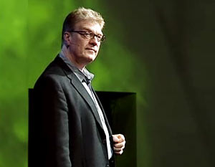

Use Language Information
Bring on the Learning Revolution by Ken Robinson
The Fireman’s Narrative: 1’19” self-contained excerpt
http://www.ted.com/talks/sir_ken_robinson_bring_on_the_revolution.html

Slide 20
Use Language Knowledge to fill in these blanks without listening to the audio
1. Now I was up in San Francisco ______ __________ago
2. doing _______ book signing
3. Uhm. __________ ______ this guy buying _____ book,
4. and he's _____ _______30s.
5. And I said, "What ____ ________ do?"
6. And ____ ________, "I'm a fireman."

Slide 21
How did you do?
a while
1. Now I was up in San Francisco _____ _________ago
2. doing _______ book signing
3. Uhm. _______ _______ this guy buying _____ book,
4. and he's ____ ______30s.
5. And I said, "What ____ ______ do?"
6. And ____ ______, "I'm a fireman."
a
There was
a
in his
do you
he said

Slide 22

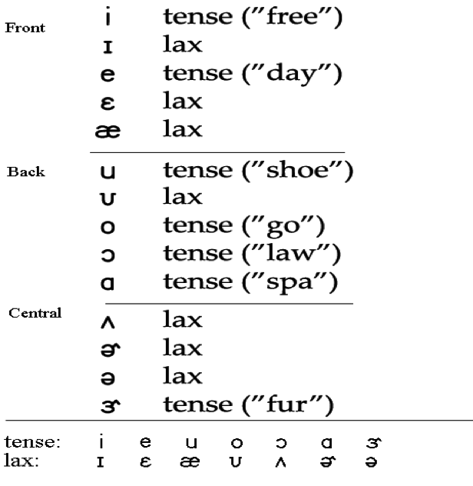
Skills Instruction
Connected Speech Features
Sounds are linked
/h/ deletion
Segmentals: C & V Sounds
Addresses V & G 2012: Segmenting a continuous speech stream

Slide 23
Connected Speech Features Reed, M, Michaud, C. (2005). Sound Concepts. NY,NY. McGraw-Hill.
/h/ deletion: ‘h’ is deleted in he, her, his, him
Except:
sentence-initial: He’s late. Where is he?
Her computer crashed.
I told her to back up her files.
contrastive stress: Did you tell him? I didn’t tell him. I told her.
Do you think he knows?
I don’t think he knows, but I think she does.
possessive pronoun: I haven’t read his. But I did read hers.
These’re mine, those’re yours. Are those his?
Are these yours? I think those are hers.

Slide 24
Two Kinds of Information to Decode Speaker Intent
Metacognitive Language Strategy
1) Identify ‘normal’ stress & intonation
— lexical: stressed syllable is longer, louder, higher, clearer
— phrasal: stressed content words; unstressed function words
— sentence-level: English normal pitch range is “dramatic pitch”
Detect special stress & intonation
— extra special pitch range for contrastive stress & implicational intonation
• Ladd, D. R., Terken, J. 1995. Modelling Intra- and Inter-Speaker Pitch Range Variation. Proc.of ICPhS. Stockholm, 386-389.
• Mennen, I. 2007. Phonological and phonetic influences in non-native intonation. In J. Trouvain & U. Gut (Eds.) Non-native
Prosody: Phonetic Descriptions and Teaching Practice, Berlin: Mouton de Gruyter.

Slide 25
New Word Checklist
Skills Instruction: Lexical Stress
New Word Checklist
1. What part of speech is it? ____________________
For Nouns: Count Noun?  Non-Count Noun? 
Singular Count Noun: a/ an/ the
Plural Count Noun: add 's'
For Verbs: Transitive?  Intransitive? 
2. How do you pronounce it?
How many syllables are there in the word? ______
Which syllable gets the (primary) stress? ______
New Word / Stress Pattern: ____________________ / ______
3. How do you use it in a sentence?
________________________________________________________
4. Alternate Forms:
__________________________________________________________
Reed, M., Michaud, C. (2005). Sound Concepts: An Integrated Pronunciation Course. NY: McGraw-Hill, p. 154.

Slide 26
New Word Checklist
New Word ____________
How do you pronounce it?
How many syllables are there in the word ______
Which syllable gets the (primary) stress? ______
Example:
economy is a 4-2 word --- 4 syllables, stress on the 2nd
economics is a 4-3 word --- 4 syllables, stress on the 3rd
New Word / Stress Pattern:
____________________ / ______
*Notation system adapted from from Murphy, J., Kandil, M. (2004). Word-Level Stress Patterns in the Academic Word List. System, 32, 61-74.

Slide 27

Skills Instruction: Normal Phrasal Stress
2.2 4.3
at work in the morning
at home at the office
at school on the table
at least for the weekend
by now to the movies

Slide 28
Skills Instruction: Standard Sentence Stress Law & Order: 3rd Person Singular
defense attorney | defend | client
jury | reach | verdict
judge | sentence | criminal
Directions:
Finish this sentence:
In a typical trial, __________________________________
Example:
In a typical trial, the defense attorney defends his client.
Liss & Reed, 2013.

Slide 29

Stress & Intonation Checklist: Making Inferences
Directions: Listen to the following 2 sentences
(1) The teacher didn’t grade the papers.
(2) The teacher didn’t grade the papers.
Q.1: Do the sentences sound the same or different? The same Different
Explain your Choice:
Sample correct Responses: Different
Number 2 has extra special pitch. Number 2 had extra stress.

Slide 30
Use Intonation Information to Decode Speaker Intent
The teacher didn’t grade your papers.
Q: Have papers been graded?
Yes
No
“Choice b: Yes, they’ve been graded
I know because ‘teacher’ has extra stress & intonation

Slide 31
Post Instruction Metacognition Student Perspective
“Before I got here (to the United States), I thought speaking was reading aloud. Now that I’m here, I realize they are very different skills.”

Slide 32
Post Instruction Metacognition Student Perspective
In response to learning about the difference between content words and function words: “Oh, it’s the dark side that I didn’t know about. It’s the yin yang. I always heard about the importance of content words, but now I see that there was another side that was missing (the function words).” Student, December, 2014.

Slide 33

Post-Instruction: Skills Level Assessing Connected Speech
Fireman’s Narrative: Recollections of his HS teacher:
I was thinking about that guy _____ other day
because six months ago, I _______ ____ life .
He was ____ ___ car wreck.
and I ________ ______ out,
and I ________ ______ CPR,
and I ________ ______ wife’s life as well.
I _________ _____ thinks better of me now.
49 words: 36 supplied; 13 blanks

Slide 34
Post-Instruction: Skill Level Assessing Connected Speech
Fireman’s Narrative: Recollections of his HS teacher:
I was thinking about that guy __the___ other day
because six months ago, I _______ ____ life .
He was ____ ___ car wreck.
and I ________ ______ out,
and I ________ ______ CPR,
and I ________ ______ wife’s life as well.
I _________ _____ thinks better of me now.

Slide 35
Study Findings: Connected Speech Cloze Test
Listening Skills Diagnostic
Dave was ___ ____ late 20s, and it would not be accurate to say that ___ ___ living at home ____ ___ parents, but only because half the time ____ _____ staying ___ ____ sister's house. ___ ____ playing in a band, doing some writing, not making much money, ____ ___ parents were worried. And one day __ ____ hanging out ____ ____ mom.
http://www.thisamericanlife.org/radio-archives/episode/401/parent-trap
Radio host Ira Glass 3-sentence introduction to This American Life episode entitled “Parent-trap”.
64 words: 46 supplied; 18 blanks.

Slide 36
Study Findings: Connected Speech Cloze Test
Repeated Measure ANOVA
(F=8.121, p<.001, n=14; F=6.863, p<.001, n=11), reveals significant differences across tests.
Close Test | Mean | SD | N
TPRE T1 T2 T3 T4 TPOST | .35307 .62514 .57671 .61293 .61393 .7429 | .264708 .134200 .162850 .226853 .179107 .16508 | 14 14 14 14 14 14

Slide 37
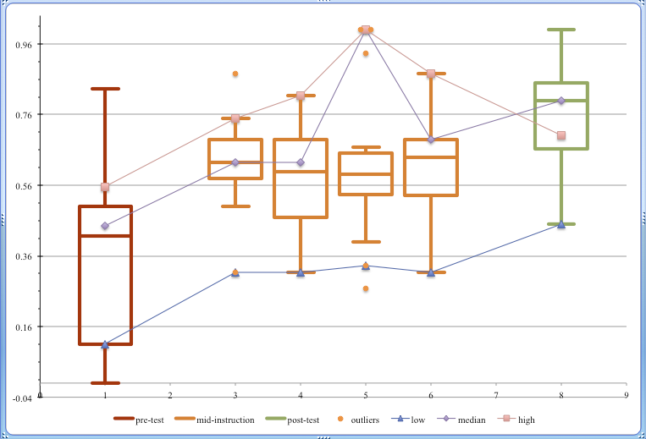
Score
Time

Slide 38
Measures of Learner Progress Metacognitive Level
Articulated metalinguistic knowledge of the connected speech features
Student Tell Backs:
Three Ways to Decode English/Connected Speech
context, language, sound
I can estimate words even though I couldn’t hear that
/h/ deletion – n=12/13
he, his, her, him when ‘h’ isn’t the first word
/h/ is sometimes omitted except contrastive word

Slide 39
Cloze Discussion
From the data, we could reasonably conclude that students’ scores in the six cloze tests increased.
Speculation: students’ metacognitive levels correlate with their segmentation skills in listening.

Slide 40
Metacognition: Pragmatic Functions of Intonation
Which of the following can intonation do in English? (T/F: Check ALL answers that apply.)
• turn a statement into a question
• turn a sincere statement into a sarcastic one
• act as oral punctuation, quotation marks, and paragraph breaks
• signal an implied contrast
• change the meaning of a sentence
• reduce the number of words needed to convey your meaning
• convey information without actually saying the words
 | Initial | Final
Mean SD | .7792 .2072 | .8569 .1939
Paired t-test (t=1.0312, df=12, p=0.3228). Mean scores increased.
Small sample size; no statistically significant difference.

Slide 41
Pre-Instruction Diagnostic Assessment
Social Media Lecture
Directions: Read the following sentences silently to yourself. When you are ready, record yourself reading the sentences aloud.
Yesterday we discussed the creation of Facebook.
Today we’ll discuss the marketing of Facebook.

Slide 42
Information Clarification
Directions: Read Sentences A and B silently to yourself. Sentence A contains a mistake. When you are ready, record yourself saying Sentence B in order to correct the mistake.
A. I think the zip code for BU is 02115.
B. No, the zip code for BU is 02215.

Slide 43
Post-Instruction Summative Assessment
World History Lecture
Directions: Read the following sentences silently to yourself. When you are ready, record yourself reading the sentences aloud.
This week we explored the causes of World War I.
Next week we’ll explore the consequences of World War I.

Slide 44
Information Clarification
Directions: Read Sentences A and B silently to yourself. Sentence A contains a mistake. When you are ready, record yourself saying Sentence B in order to correct the mistake.
A. I think the main number for BU is 617-352-2000.
B. No, the main number for BU is 617-353-2000.

Slide 45
Social Media Lecture and World History Lecture
Fisher’s exact test shows that there is no statistically significant difference between groups (p=1)
 | SML | WHL | Total
Yes No | 3 9 | 2 10 | 5 19
Total | 12 | 12 | 24
N/A | 2 | 2 | 4

Slide 46
Information Clarification
Fisher’s exact test shows that there is a statistically significant difference between the two group (p<0.001)
 | Initial IC | Final IC | Total
Yes No | 1 9 | 10 1 | 11 10
Total | 10 | 11 | 21
N/A | 4 | 3 | 7

Slide 47
Measures of Learner Progress Metacognitive Level
Articulated metalinguistic knowledge of pragmatic functions of Contrastive Stress & Intonation
Student Tell Backs:
English normal intonation has “dramatic pitch”
We should pay attention to the stress of words, phrases, sentence to be clear what we want to say
Stress - changing the meaning of the sentence
NSs care italics and they pronounce them up & down = pitch
If I care my stress I say it louder, longer, higher, clear
If I put the right stress on the right words, the listener more clear know my point

Slide 48
Conclusion
Students’ listening segmentation skills improved throughout the semester
Possibly attributable to increased metacognition
Additional data required to confirm a correlation

Slide 49
Conclusion, Continued
Students’ mean post-instruction metacognition level is higher than pre-instruction
Direction of ongoing research: increase instruction-phase metacognitive diagnostics
Students’ Information Clarification metacognitive awareness increased significantly
Students’ ability to produce target-like contrastive stress and pitch varied
In some cases, achieved Louder, but no pitch change
In some cases, incorrect lexical stress masked target

Slide 50
References
Goh, C. (2008). Metacognitive instruction for second language listening development: Theory, practice and research implications. RELC Journal, 39(2), 188-213.
Liss, T., Reed, M. (2013). Teaching not Testing: Strategies for Teaching & Assessing Listening Skills, MATSOL Annual Conference, Boston, MA.
Mendelsohn, D. (2006). Learning how to listen using learning strategies. In P. Gorden (Ed.), Current trends in the development and teaching of the four language skills. Mouton deGruyter, pp. 75-89.
Reed, M., Michaud, C. (2005). Sound Concepts: An Integrated Pronunciation Course. NY: McGraw-Hill, p. 154.
Rose, K. , Kasper, G. (Eds.). (2001). Pragmatics in language teaching. Cambridge: Cambridge University Press.
Searle, J. (1969). Speech Acts. Cambridge University Press.
Vandergrift & Goh (2012). Teaching and learning second language listening: Metacognition in action. NY: Routledge.

Slide 51
Thank you
Any Questions?

Slide 52

Sound file

