Slide 1
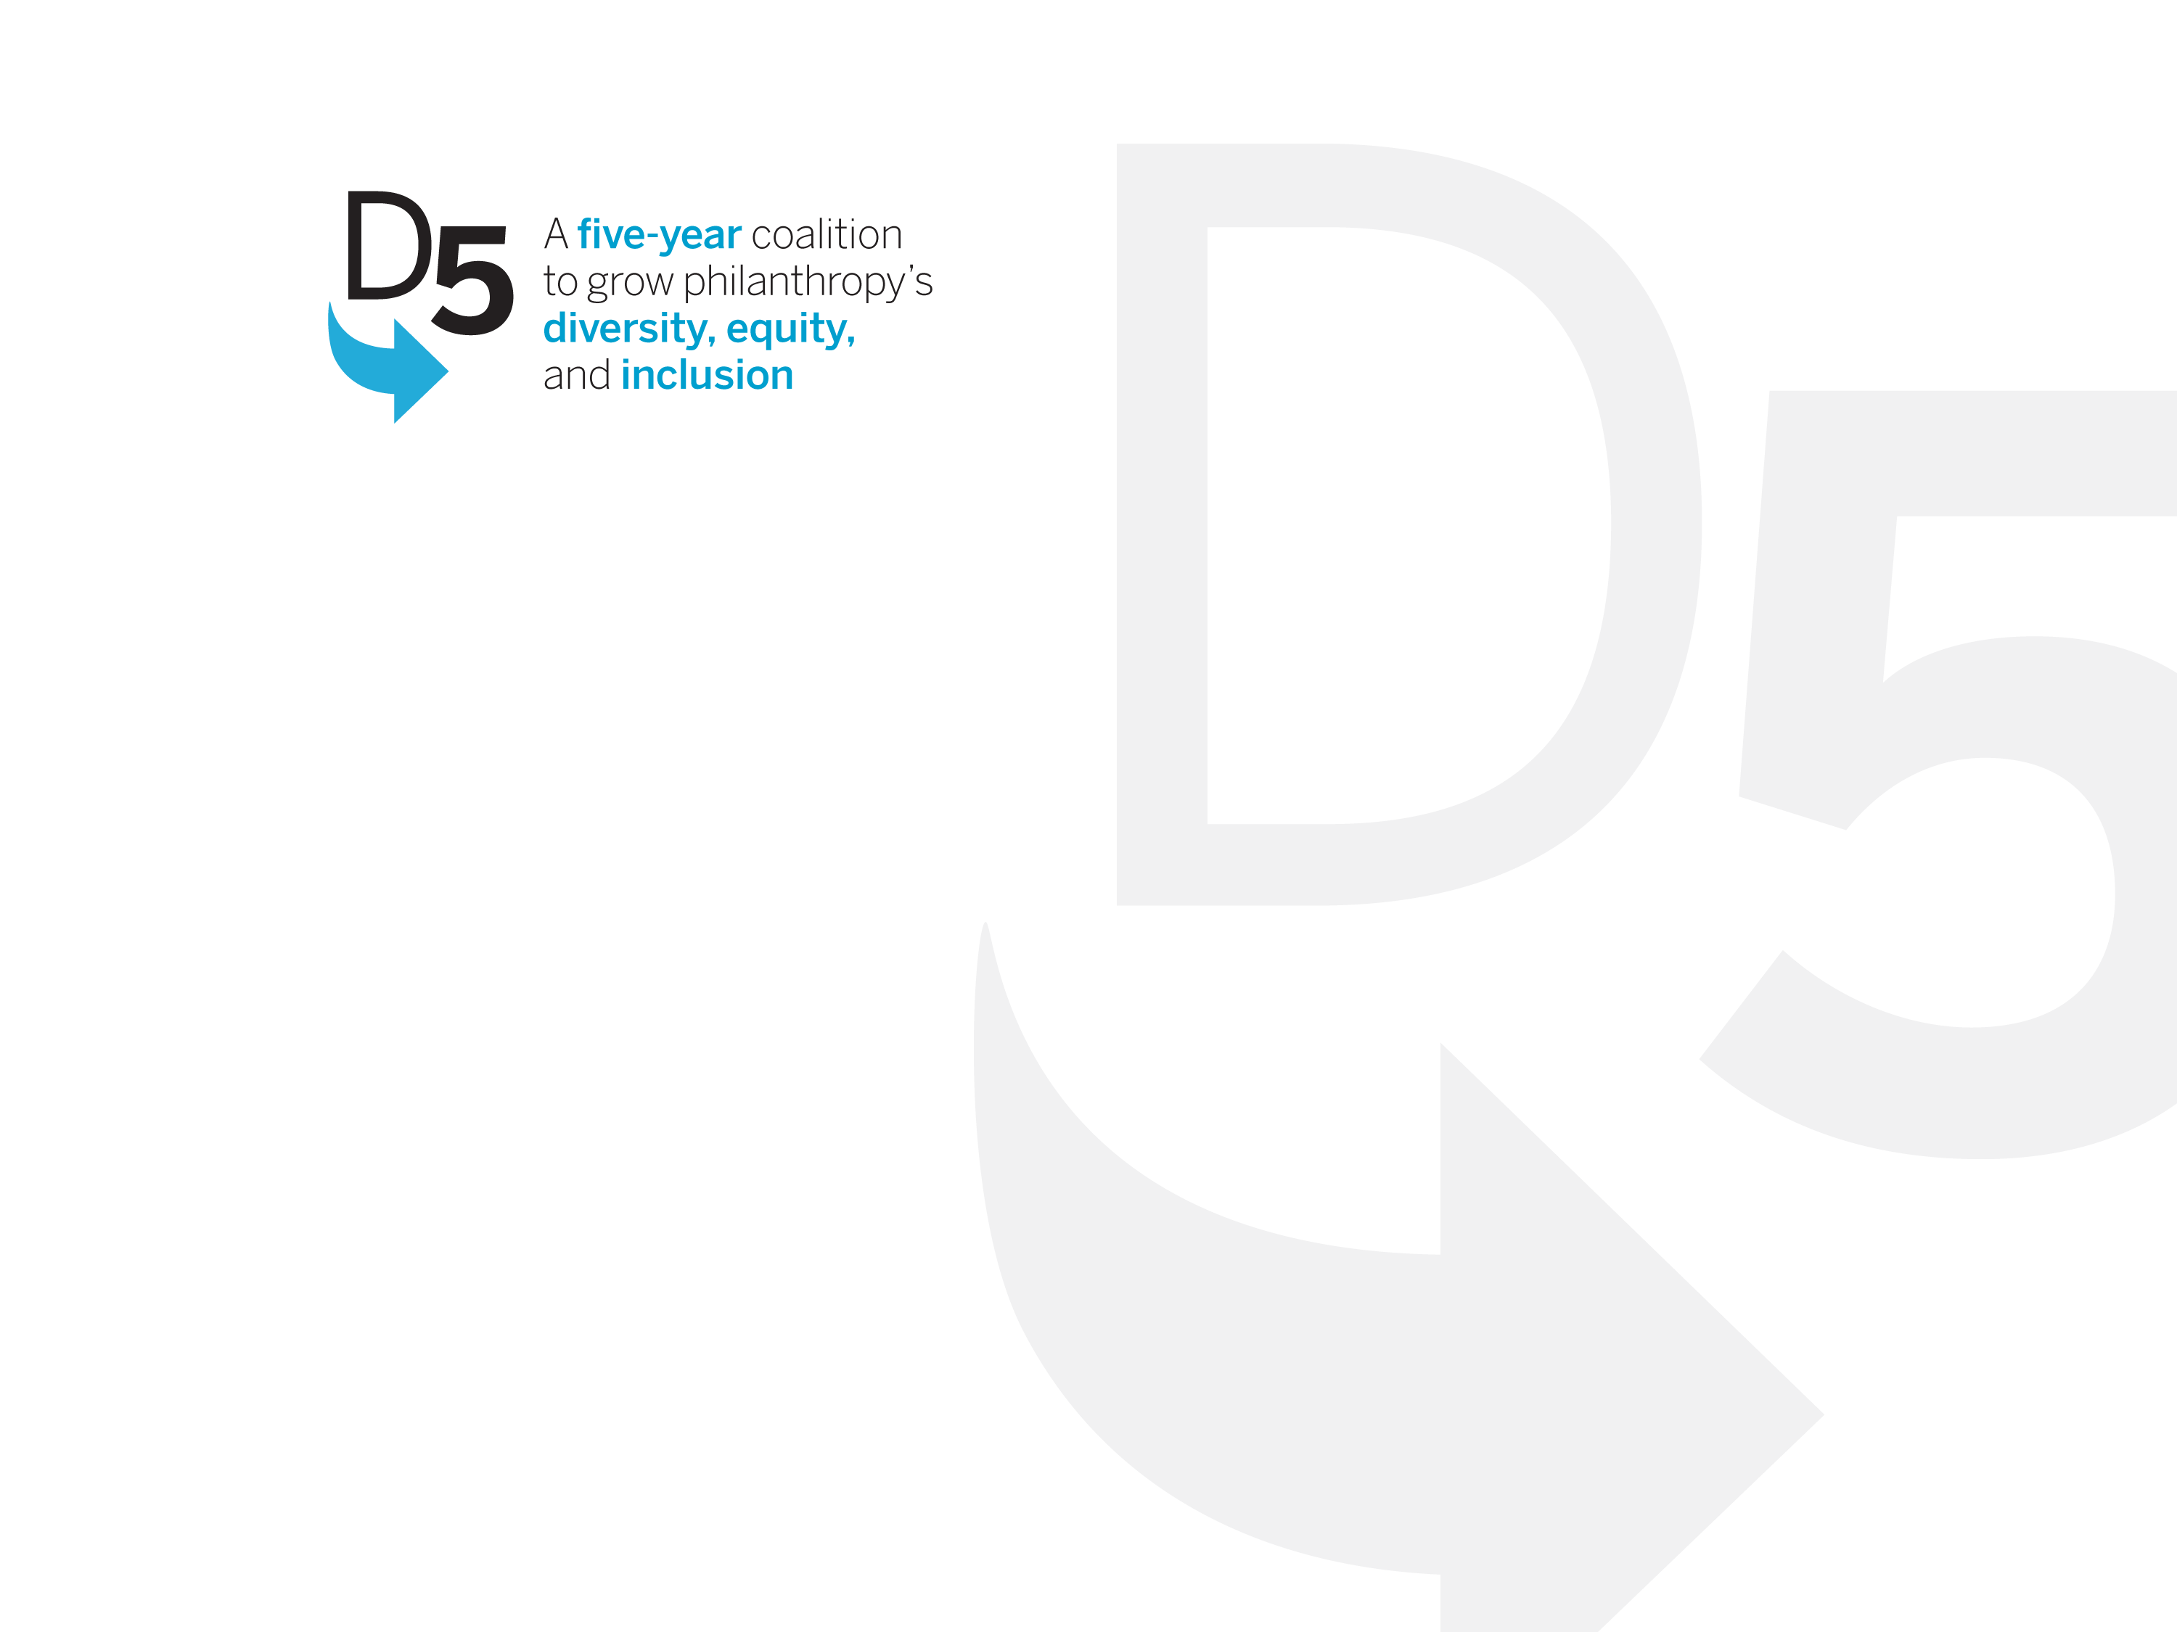
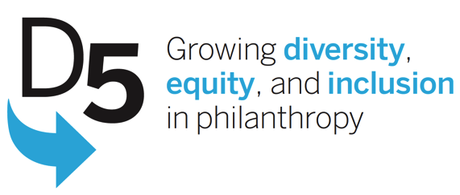
D5: From Coalition to Movement
GEO Collaboration Conference
Houston, TX 2015

Slide 2

Imagine philanthropy…
achieves lasting impact by drawing on the power of diverse staffs and boards
forges genuine partnerships with diverse communities
increases access to opportunities and resources
for all people.
the vision

Slide 3




Four Big Goals
Recruit diverse leaders for foundations—including CEOs, staff, and trustees
Increase funding for diverse communities and ensure that foundations offer all constituencies equal opportunity to access the resources they need
Improve data collection and transparency so we can measure progress
Identify the best actions we can take in our organizations to advance diversity, equity, and inclusion
the priorities
Notes:
Background on D5 and strategy

Slide 4

Better Together
D5 Funders
The California Endowment
W.K. Kellogg Foundation
Robert Wood Johnson Foundation
Rockefeller Brothers Fund
David and Lucile Packard Foundation
Rockefeller Foundation
Marguerite Casey Foundation
The Prudential Foundation
Annie E. Casey Foundation
Lloyd A. Fry Foundation
Evelyn and Walter Haas, Jr. Fund
Jessie Smith Noyes Foundation
Rosenberg Foundation
D5 Leadership Team (original)
Paul Bachleitner, Joint Affinity Groups
Carly Hare, Native Americans in Philanthropy
Mae Hong, Rockefeller Philanthropy Advisors
Lawrence McGill, Foundation Center
Ronna Brown, Philanthropy New York
Vicki Rosenberg, Council of MI Foundations
Roger Doughty, Horizons Foundation
Karen Zelemeyer, Funders for LGBTQ Issues
And Growing…
the coalition

Slide 5
Coalition Partners
Director
JAG (6)
Foundation Center
Regional Associations (35)
Pop. Focused Funds (450+)
CoF – 1000+ members

Slide 6
Structure as Envisioned by Funders

Slide 7
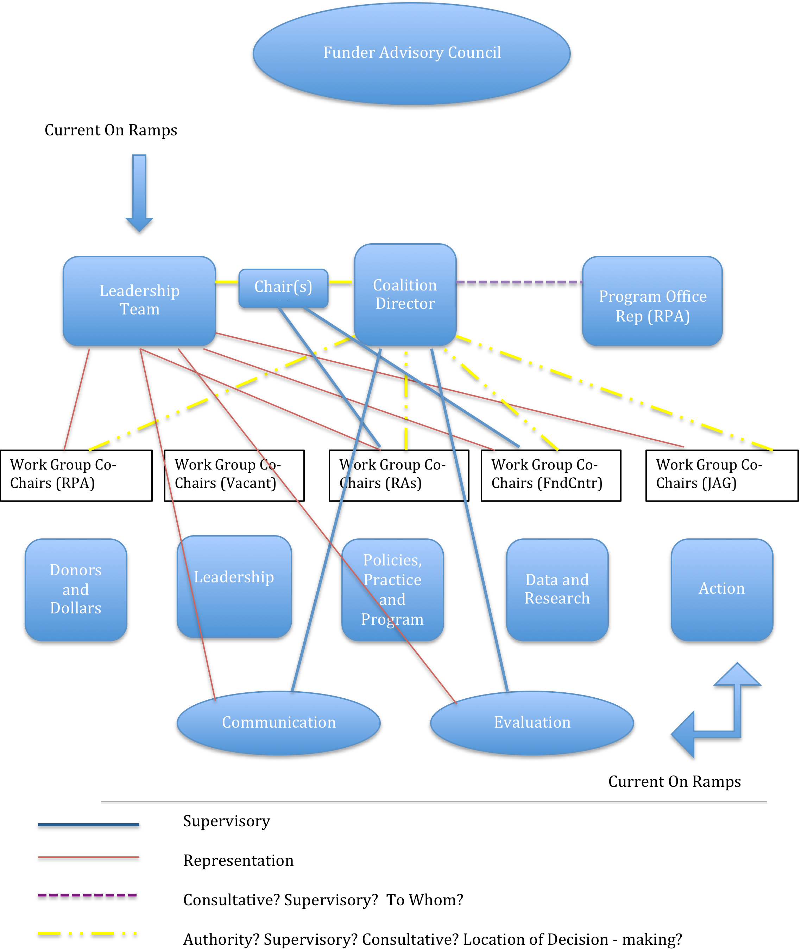
Structure as Envisioned by Partners

Slide 8
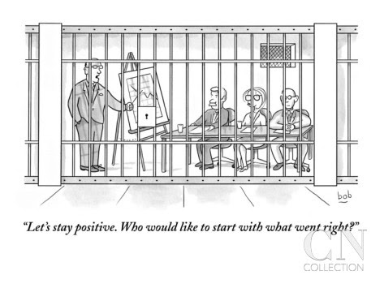

Slide 9
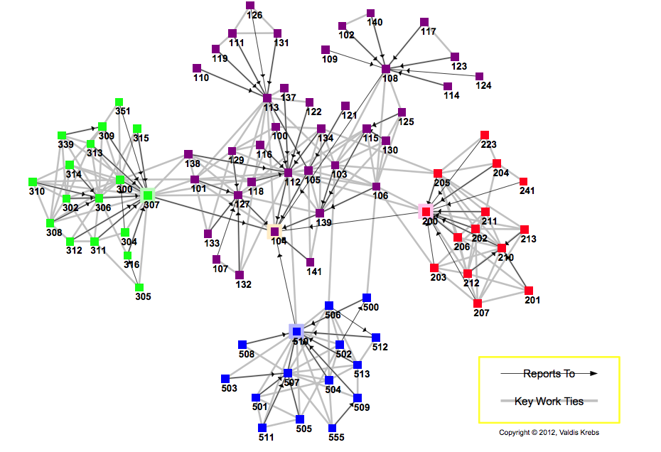
New Structure
(representation)

Slide 10
Key Accomplishments
Facilitated the strengthening of field wide data collection system
Provided overarching voice of inclusion and accountability that broadened the range and number of philanthropic institutions engaging these issues
Provided field with a strategic communications framework for effective messaging to targeted audiences

Slide 11
Key Learnings/Lessons
To ensure that the best practices of collaborative work outlined in GEO’s “Building Collaboration from the Inside Out:’ can be operational, collaborative funders of collaborative efforts should ensure:
Establish clear lines of accountability
Establish feasibility of goals/outcomes
Ensure clarity on distribution of resources
Address conflicts of interests with respect to oversight and execution
Anticipate the need for flexibility on strategy and approach
Ensure that process/structure does not impede impact

Slide 12
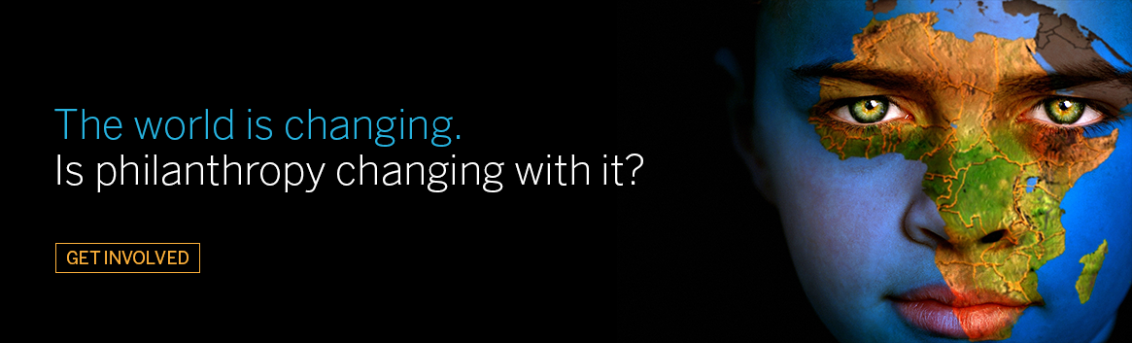
Notes:
Summary and conclusion
This is no longer optional or ancillary
Philanthropy across the board must strengthen its ability to effectively engage diverse communities if they are to be relevant, effective and sustainable
Increasing inequity and huge pots of resources will continue to come under scrutiny; must be prepared to speak to its relevance

