Slide 1
Collaborative Civic Leadership
A Workshop for Grantmakers
Mark Scheffler
Marcy Levy Shankman
Chris Thompson

Slide 2


Slide 3
The Civic Arena
CIVIC
Public
Private
Non-Profit
Philanthropic

Slide 4

Complex Civic Systems
Multiple, diverse stakeholders
Absence of control

Slide 5



Complex Civic Systems

Slide 6
What Do
Civic Systems Look Like?

Slide 7
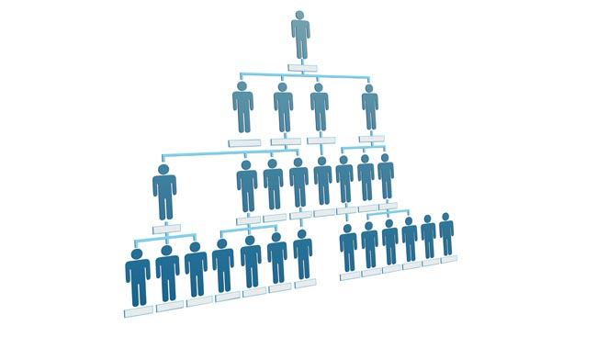
Organizations & Systems

Slide 8

Organizations & Systems

Slide 9

Organizations & Systems

Slide 10



Grantmakers’ Role in Civic Systems

Slide 11
Organizations | Systems
Clear lines of authority | Diffuse authority
Explicit policies & procedures | Implicit rules of interaction
Set roles & responsibilities | Diverse roles & responsibilities
Defined goals & objectives | Emergent goals & objectives

Slide 12
Practice Inquiry
Collaborative Leadership
Assess Context
Build Trust

Slide 13

Practice Inquiry
Collaborative leaders use inquiry to understand:
Systems context
Motivations and priorities
Levels of trust
Notes:
So how do leaders learn whether there is a compelling cause, whether the climate is right and what chunk to take on first?
They use their inquiry skills. Inquiry also helps leaders better understand the motivations and priorities of the other stakeholders, and what it will take to build trust among those stakeholders.
Inquiry is an essential skill to exercise collaborative leadership. Inquiry is an approach to leadership that is about emergent ideas and ways vs. traditional top-down hierarchical “pull” of standard organizational leadership.

Slide 14
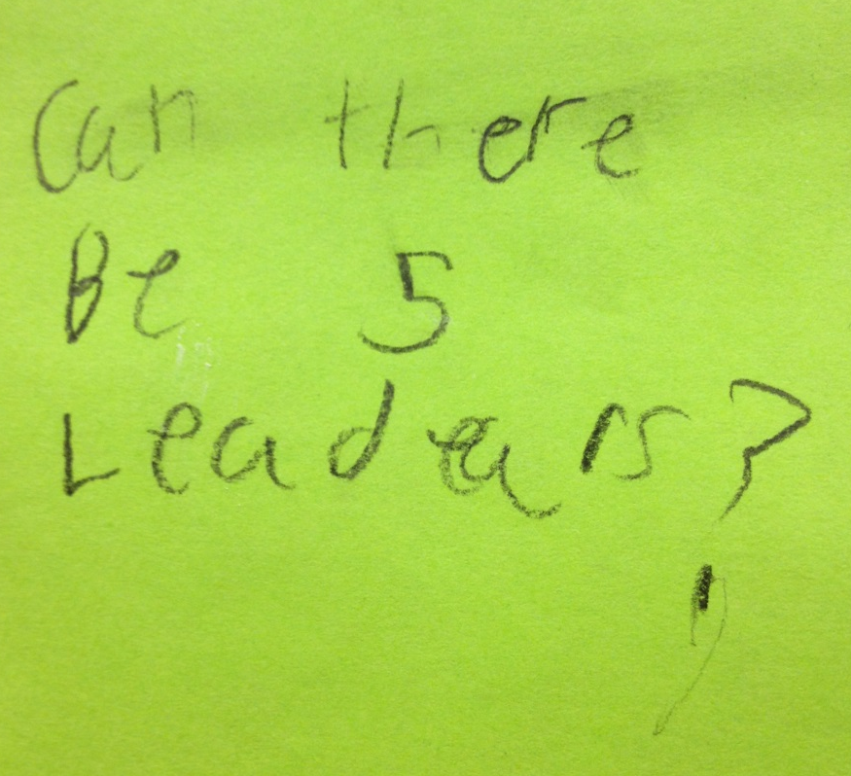
Compelling Questions
Inspire creativity
Improve decision-making
Create a learning opportunity
Direct focus
Engage others
Influence thinking
Notes:
There are many elements to inquiry, but they all start with being able to ask compelling questions that surface the key issues that will either make collaboration possible or make it clear that the time isn’t right for collaboration.
Compelling questions aren’t just open ended questions. They are open-ended questions with a specific purpose. We can get better at asking compelling questions by practicing them.

Slide 15

Compelling Questions
Notes:
Collaborative leaders use compelling questions to help stakeholders explore what is possible.
Collaborative leaders use them to invite stakeholders to engage in a process to develop and achieve shared goals.

Slide 16

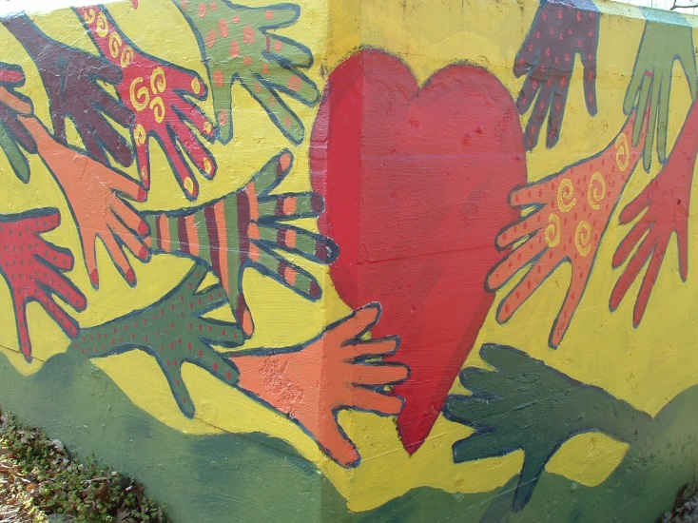
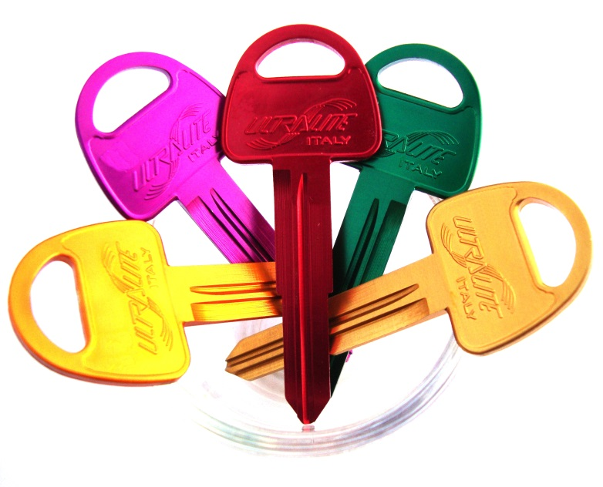
Compelling Questions
Notes:
Compelling questions help us develop the foundation for a shared understanding about the system and the respective perspectives of the players in the system.
Foundational: Explore what we value, what we desire and what assumptions need to be abandoned
Aspirational: Explore what will be different, what we will learn and what is possible
Procedural: Explore what conditions need to be in place, what would we do differently, what is missing
They help us explore what we could do together and what we aspire to achieve.
And they help us understand what will be necessary for stakeholders to take the risk of entering into a collaboration.

Slide 17
Examples
What do you value the most about other stakeholders within the system?
How would you describe a highly functioning system?
When you’ve experienced positive change, how did stakeholders interact with each other?
Notes:
Help participants to practice asking compelling questions of each other and/or leaders with a track record of collaboration.

Slide 18



Assess Context
Climate
Chunkiness
Capacity

Slide 19
Grantmakers & Context
What are compelling questions that grantmakers could ask to:
  Improve the climate for collaboration?
  Identify the initial chunks for work?
  Build support for collaboration capacity?

Slide 20

The Currency of Collaboration
Notes:
We also use compelling questions to better understand what it will take for stakeholders to trust each other enough to enter into a collaboration. Collaborations by their nature are risky propositions. We are much more willing to take a risk with those we trust.
Trust is what makes collaboration possible. Collaborations move at the speed of trust.

Slide 21




Collaboration & Trust
  Other currencies of leadership are less relevant
  Credibility & influence predicated on trust
  Economic impact of trust
Notes:
Within complex systems power and authority are not nearly as relevant as is our ability to build trust so that we have more credibility and influence with other players in the system. Collaboration moves at the speed of trust – if there is low trust stakeholders spend valuable time checking up on each other. If there is high-degrees of trust stakeholders are willing to make more significant contributions to the collaboration effort; allowing the collaboration to go further, faster.

Slide 22
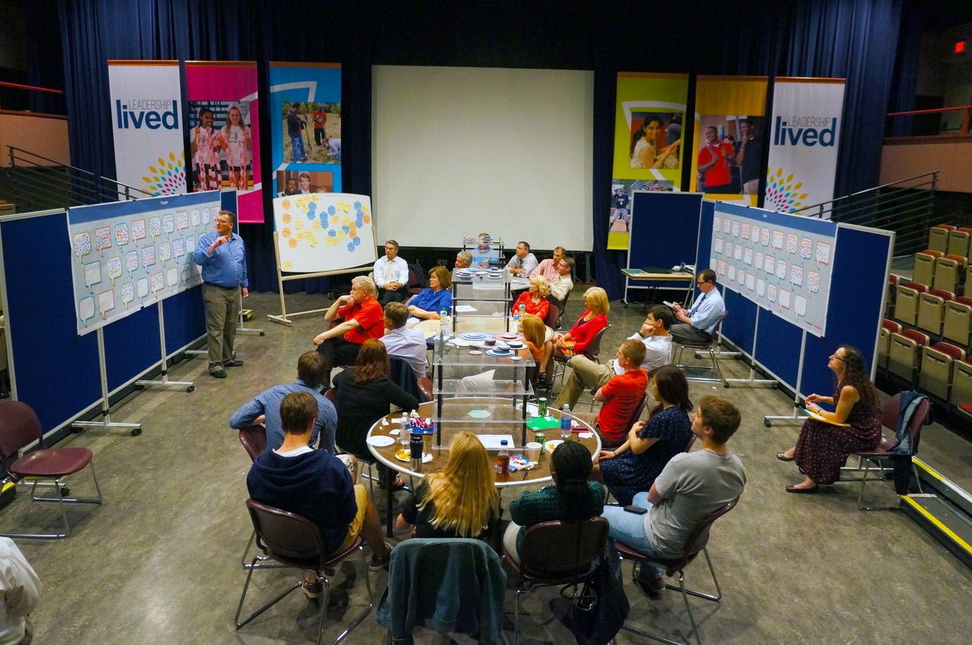

Build Trust
Notes:
Collaboration does require us to sit in a lot of meetings like this one. But we’ve learned that for these meetings to be productive they must be preceded by one-on-one sessions that are explicitly designed to build trust. Grantmakers that support collaborations should not only carve out time and resources for group convenings, but also assure there is sufficient time for leadership to build trust with each other.

Slide 23

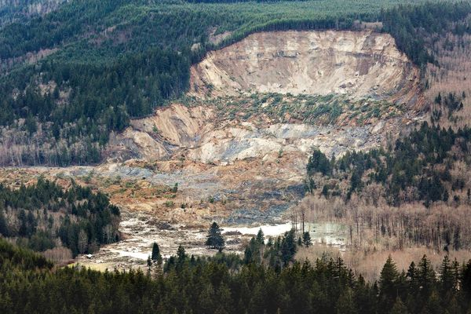
Build Trust
Notes:
Trust builds slowly over time; like sedimentary rock, but erodes precipitously. Broken trust lasts forever; unless it is restored through leadership.

Slide 24

Key Elements to Building Trust
  Behave predictably and consistently
  Communicate clearly
  Treat promises seriously
  Be forthright and candid
  Source: Kouzes & Posner

Slide 25
Grantmakers & Trust
Identify trust levels within system
Create space for trust to be built
Create capacity to build trust
What compelling questions need to be asked about your organization’s role in building trust?
Notes:
Exercises can help us better understand and appreciate the value of trust.
We can ask compelling questions of proven collaborative leaders to understand what it takes to move from a low to a high trust environment.

Slide 26

Back Home

Slide 27
Contact Us
Mark Scheffler
mscheffler@leadershipakron.org
@mschefflerakron
Marcy Levy Shankman
mshankman@cleveleads.org
@Shankmaneil
Chris Thompson
cthompson@thefundneo.org
@ccarsonthompson

