Slide 1
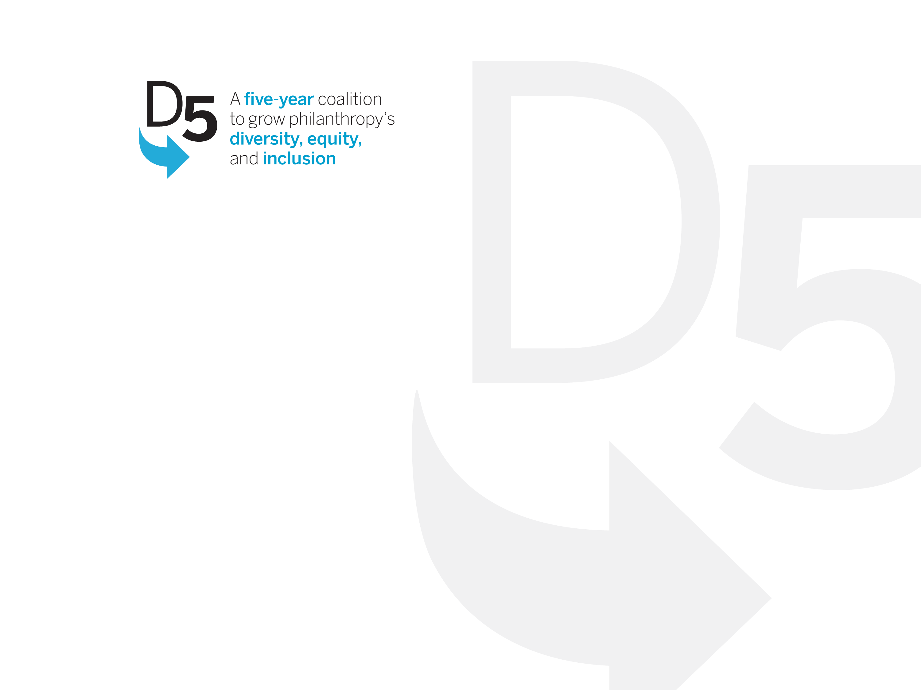
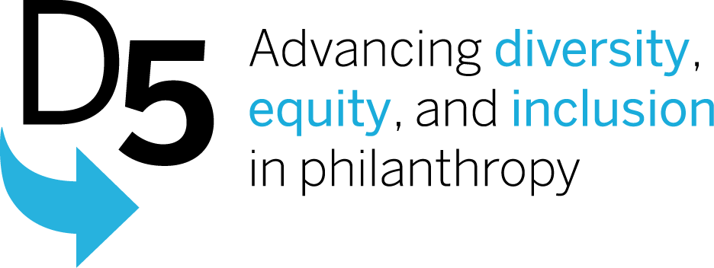
D5 Coalition: Progress and Impact
and Next Steps
GEO Focus Group
November 2015

Slide 2




Four Big Goals
Recruit diverse leaders for foundations—including CEOs, staff, and trustees
Increase funding for diverse communities and ensure that foundations offer all constituencies equal opportunity to access the resources they need
Improve data collection and transparency so we can measure progress
Identify the best actions we can take in our organizations to advance diversity, equity, and inclusion
the priorities

Slide 3
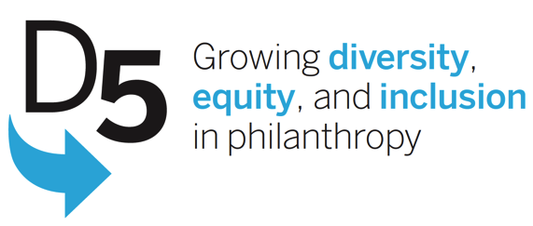
Agenda for Today
Welcome and Introductions
Presentation
  Reflections on D5 Process and Impact
  Input from Learning and Evaluation Partner
Discussion
  Your perspectives on the current state of diversity, equity and inclusion discourse and action in philanthropy?
  What does the field need to further/deepen this work?
  How can that best be accomplished and by what means?
Next Steps
Adjourn

Slide 4
New foundation CEO, staff, and trustee appointments more closely reflect U.S. demographic trends
  Focus was on CEOs – high touch engagement and messaging highlighted new and unanticipated leaders taking on the work.
  Peer groups at the regional level had considerable momentum (Pacific Northwest, Philadelphia, Chicago)
  No clear strategy for Trustees, so there was limited progress; Trustee census and 2015 focus groups/interviews will inform subsequent strategy
Philanthropy has the research capacity to be more transparent about progress on DEI
  Increase in foundations participating in CoF Compensation Survey (688 in 2010 to over 1000 in 2014); (see slide 6 for progress to date)
  Strengthened insights on internal foundation and nonprofit diversity - GuideStar Exchange to collect data on NPO leadership/staff
  Strengthened insights on grants diversity - Foundation Center and Forum of Regional Associations’ “Get on the Map”
  Insight on populations impacted by grants – next arena is constituent data collection
progress & outcomes
Notes:
Diverse Leaders: Key Insight
Issue, Insight & Implication
Insight: Senior leadership needs peer support, concrete tools and opportunities to build relationships with diverse peers to facilitate efforts to diversify their ranks.
Question: How can we strengthen the support and tools available to CEOs and trustees to act as leaders on this issue for their peer?

Slide 5
Annual funding for diverse communities increases substantially
  Analysis of Population Focused Funds clarified their contribution > diffuse field, mixed impact, changing role within larger field of philanthropy
  Interest in engaging and showcasing diverse donors > changing the narrative of who is philanthropic
  Change in amount of actual dollars to communities impossible to assess without better data
More foundations take meaningful action to address diversity, equity, and inclusion issues in their organizations
  State of the Work, research reports and Policies, Programs and Practices Scan being used to spur internal engagement and conversations
  Regional cohorts reflect power of peer support and accountability
  More arenas taking action – family foundations, issue-based cohorts, intermediaries
  Clear need for more intensive guidance on execution of successful DEI practice and partnerships with consultants to support and facilitate action
progress & outcomes
Notes:
Funding: Key Insight
Insight: Few foundations are addressing equity—and even DEI leaders lack a clear definition and agenda.
Question: What should we do to establish a common definition and agenda?
Comment: The funding goal is to increase funding to diverse communities. Focusing the conversation only on funding from diverse donors to diverse communities seems limiting for this conversation, no? How about focusing this discussion on equity instead? (KB Notes: I think it would be a mistake to try to tackle the equity discussion here; it’s too fraught and we won’ get agreement> Plus we don’t know the real level of funding to diverse communities because we don’t have good data. So I think that would be a distraction here)
(Here’s what you first wrote:
Key Insight: Creative efforts to “change the narrative” about who is a philanthropist can unlock the potential of this strong and growing arena.)

Slide 6
Review of D5 Structure and Process Implications for After 2015
Review of what worked:
D5 played a unique role as a neutral, focused “authoritative” party, seen as legitimate to a broad cross-section of philanthropy
Kept emphasis on broad concepts of DEI; ‘bridger/connector’ role leveraged the work of key partners for deeper substance and expertise
Developed and executed on an inclusive, aspirational message based on research and a strategic focus on target audiences
5-year goal added sense of urgency
Review of challenges:
Initial structure constraining; needed more flexibility to capitalize on momentum where it surfaced and to engage other key allies
More time and role clarity required to develop effective collaborative engagement of key partners
Take Five Campaign slow to take off; need more segmented focused call to action
5-year goal was too short a timeframe for the size of agenda
progress & outcomes
review & implications

Slide 7
D5 Evaluation and Learning Update:
2015 Interviews
What the field understood about D5’s goals, work, and niche
What kinds of activities and events had the greatest participation and added the most value
Perception of D5’s biggest contributions thus far
Ideas of DEI needs for the future
Additional ways D5 might provide assistance
Findings will inform broader, field-wide survey in Fall 2015.
I – Infrastructure organization
RA—Regional association
A—Affinity group
F—Private foundation
CF– Community foundation
FF—Family foundation
CorpF—Corporate foundation
C--Consultant
7
evaluation & learning

Slide 8
D5 Evaluation and Learning: Interview Highlights
Most were aware of D5’s work.
  Those aware tended to be engaged in DEI work within their organization, and valued D5 as a DEI resource, and its field-level inclusive, bridging position across affinity groups and interests; did not attribute their organizational DEI change to D5.
  Those less aware were typically not engaged in DEI work but interested in casemaking and assessment tools.
High contact/personal approach of one-on-one conversations, conferences and meetings, along with word of mouth are greatest entry points (rather than social media).
Highest engagement activities are using State of the Work, research reports and tools, and attending meetings/discussions in which D5 presented or sponsored.
Many value D5’s authoritative voice using data and research to back up making their own organizational case.
Majority believe there is an ongoing need for an entity such as D5, preferring a field-wide, bridging entity of its own.
Diversifying boards and staff is cited as the greatest challenge.
8
evaluation & learning

Slide 9
Post-D5 Options Surfaced to Date
Sunset as planned, produce final report with no further action
  Ensure materials, research and database have a permanent home
Extend D5 with same four goals and refined workplan
Extend D5 with focus on refined goals based on learnings and momentum (e.g., Trustee engagement strategy)
Select specific infrastructure groups to carry forward elements of D5’s work
Launch RFP to support strategies to promote DEI work within and by existing infrastructure organizations
Other?
preparation for transition

Slide 10
For more information on D5 Coalition’s work visit www.d5coalition.org
To give input on what you think philanthropy needs going forward regarding issues of diversity, equity and inclusion, please contact Gerri Spilka at Equal Measure - GSpilka@equalmeasure.org

