Slide 1
Facing Funders’ Challenges in Walking the Talk
Marianne Hughes & Courtney Bourns
November 17, 2015

Slide 2
Introductions in trios
ROUND ONE:
What is currently inspiring in your work?

Slide 3
Introductions in trios
ROUND TWO:
What do you hope to get out of this session?

Slide 4
Desired Outcomes
A shared understanding of the distinction between collaborative efforts, networks and movements
Increased awareness of the challenges grantmakers face in building, managing and weaving networks
Increased clarity on how to handle the gray areas and overcome the challenges funders face in network-building

Slide 5
The unit of action in the 21st century is the network, not the organization
ANDREW ZOLLI

Slide 6
NETWORKS STRATEGIC ALLIANCES COALITIONS MOVEMENTS PUBLIC-PRIVATE PARTNERSHIPS COLLECTIVE IMPACT INITIATIVES
FORMS OF COLLABORATION
* GEO publication Building Collaboration from the Inside Out

Slide 7
NETWORKS
FORMS OF COLLABORATION

Slide 8
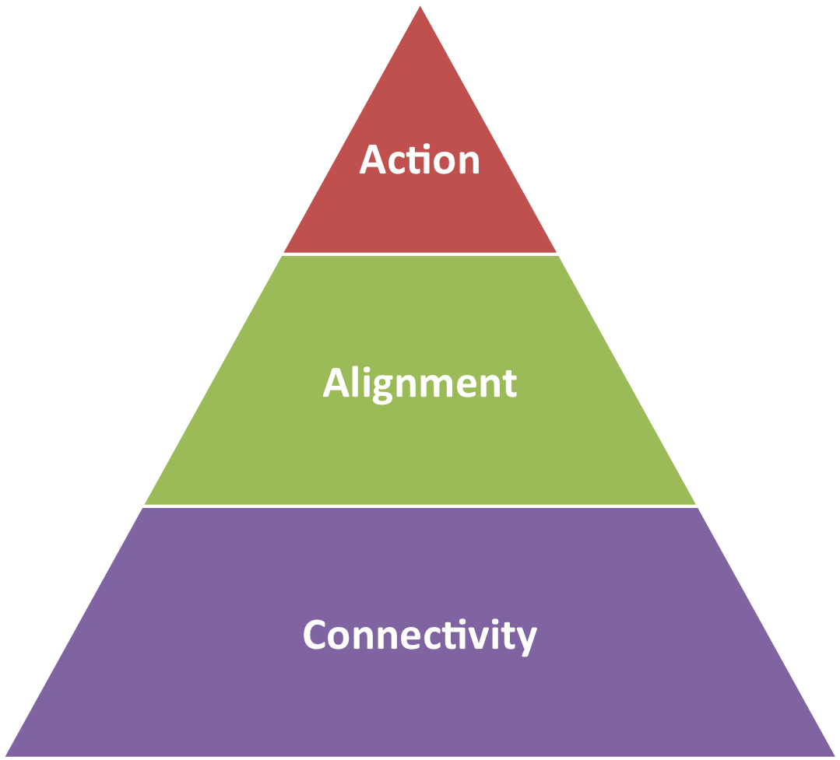
Types of Networks
*Adapted from Net Gains

Slide 9
Types of Networks
* Adapted from Net Gains
Connectivity | Alignment | Action
Connects people to allow easy flow of and access to information and transactions. | Aligns people to develop and spread an identity and collective value proposition. | Fosters joint action for specialized outcomes (goods, services, advocacy) by aligned people and organizations.
Network Weaving – help people to meet each other, increase information sharing | Facilitating – helping people explore potential shared identity and value proposition | Coordinating – helping people plan and implement collaborative actions

Slide 10
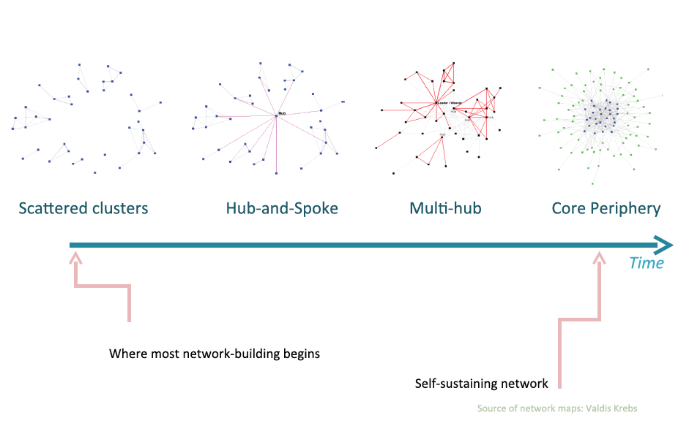
Stages of Network Development

Slide 11

NETWORKS NEED TO BE MANAGED
Birds of a feather flock together
Those close by form a tie

Slide 12
FUNDER’S ROLE/RESPONSIBILITY
Weaving & Connecting
Seeing the big picture
Making the case
Building alignment
Facilitating understanding
Providing resources: money, capacity building, knowledge, access to networks
Encouraging evaluation Attracting other resources

Slide 13
Most of the barriers to group action have collapsed and without those barriers we are free to explore new ways of gathering together and getting things done.
CLAY SHIRKY

Slide 14


Slide 15
A healthy, resilient and sustainable food system for New England
O U R V I S I O N
By 2060, at least half of the food consumed in New England
will be produced in the six New England states. (“50x60”)

Slide 16
R E G I O N A L PORTFOLIO
Networks

Slide 17


Slide 18
In Trios (12 min)
Describe the type of network in which you are working and your role in it.
Identify the two most vexing issues that you would like to work on this morning.
Write them down

Slide 20
Types of Networks
*Adapted from Net Gains

Slide 21

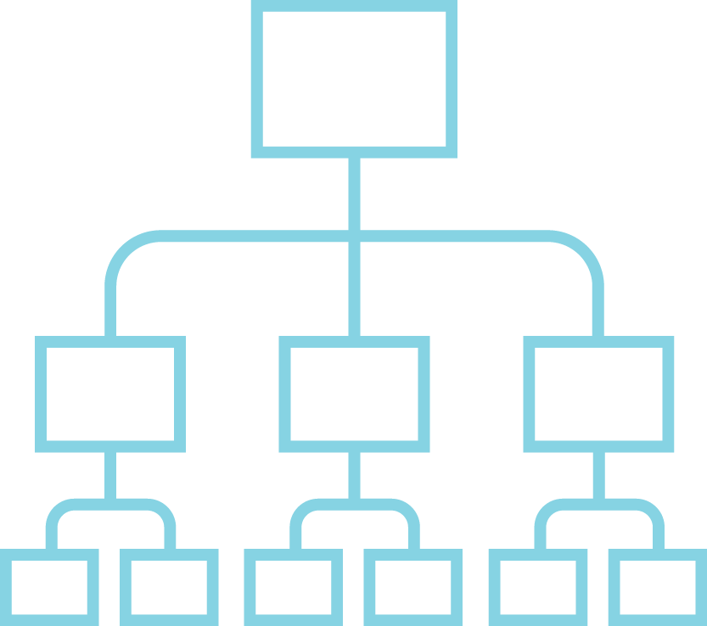
Networks
vs.
Traditional Org. Chart

Slide 22
1.Focus on mission, not organization 2. Exercise trust, not control 3. Lead with humility, not brand 4. Think like a node, not a hub
GOOD ADVICE FROM A
GEO PUBLICATION
Cracking the Network Code
Notes:
Key values/behaviors of collaboration
Humility
Partnership Listening No one right way
Cracking the Network Code, GEO, along with Jane Wei Skillern, Nora Silver and Eric Heitz,

Slide 23
Instructions
1. In TRIOS, choose one person’s challenge/gray area to work on. This person becomes the coachee. (3’)
2. Coachee provides context on the current situation (7’)
3. Coaches ask open-ended questions and LISTEN, without solving the problem (10’)
4. Coaches offer solutions/suggestions (10’)
5. Coachee shares what most resonates with him or her (5’)
6. Two coaches share: how does this learning apply to your network? (10’)

Slide 24

Debrief Questions
What are the key take-aways from your coaching sessions?
What have you learned here today that you will apply to your work back home?

Slide 25

Notes:
So you are PART of the network….what is the right way to BE?

