Slide 1
With a little help:
Overcoming e-resource management understaffing
Michael Fernandez
E-Resources Librarian
American University
ER&L 2016

Slide 2
“Demand for electronic resources has steadily declined, as researchers are using them less and less.”
- Literally No One Ever

Slide 3


American University: At a glance
- 11,000 FTE
- $4.5 million e-resources budget
        - 400+ databases
        - 125,000+ e-journals
        - 300,000+ e-books

Slide 4
The Incredible shrinking e-resources unit
E-Resources Librarian
E-Resources Specialist
E-Resources Specialist
E-Resources Applications Administrator
VACANT
vACANT
VACANT
VACANT

Slide 5

https://www.flickr.com/photos/jeremybrooks/4057788328/
What to do now?

Slide 6
Where to look for help
- Evaluate workflows, identify areas that overlap, redistribute accordingly
- Empower non-ERM staff through cross-training
- Demystify the ERMS and other scary sounding tools
- Form cross-departmental teams comprised of relevant stakeholders
- Ask: what can your vendors do for you?
- Look for extra help (if you can)

Slide 7
How to help yourself
- Cross-training, again
- Erase distinctions between professional & para-professional work
- Break down silos (when appropriate)
- Document, document, document (then document some more)
        - Consolidate scattered documentation
        - LibGuides, wikis, shared network drives, Google Drive

Slide 8
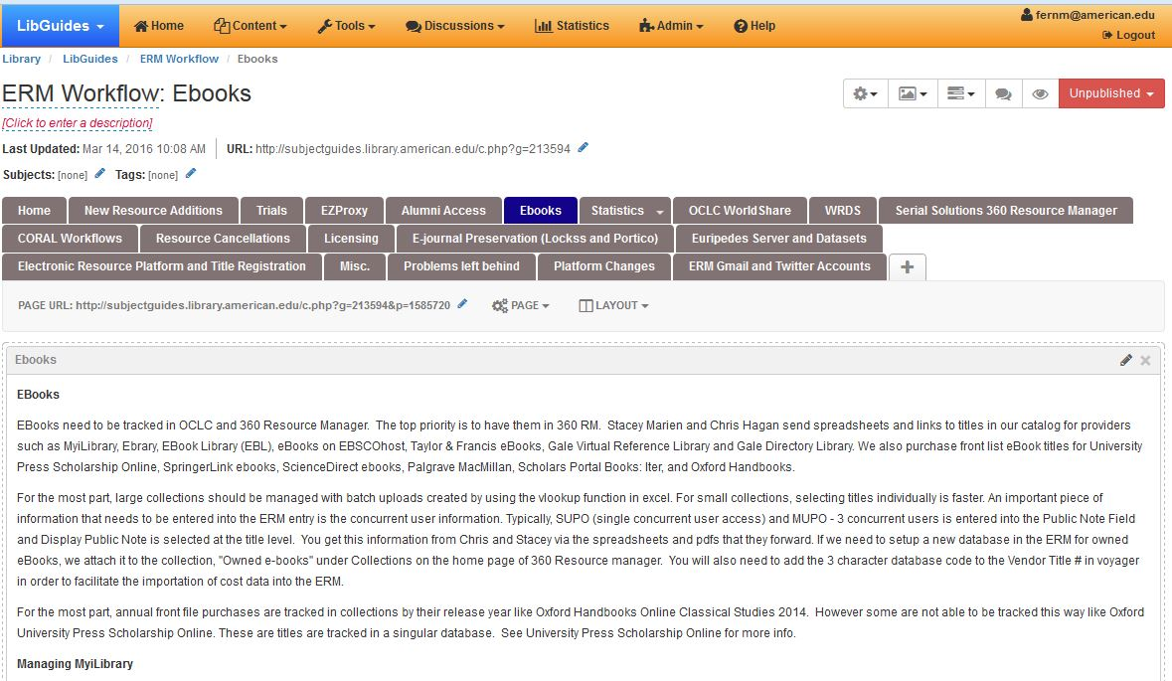

Slide 9
How to help yourself (cont.)
- Make sure departing staff don’t take institutional knowledge with them
- An ERMS requires your constant care and attention
        - Update contacts, admin passwords, license information
        - Only as good as the maintenance you put into it
- Use workflow management tools
- Open up lines of communication
        - Shared unit email
        - Chat
        - Shared calendar
- Identify tasks that can be let go (at least temporarily)

Slide 10
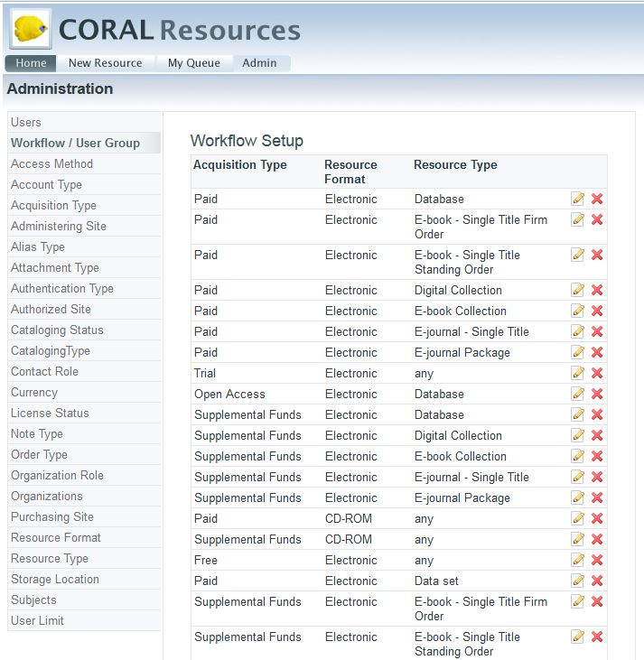

Slide 11
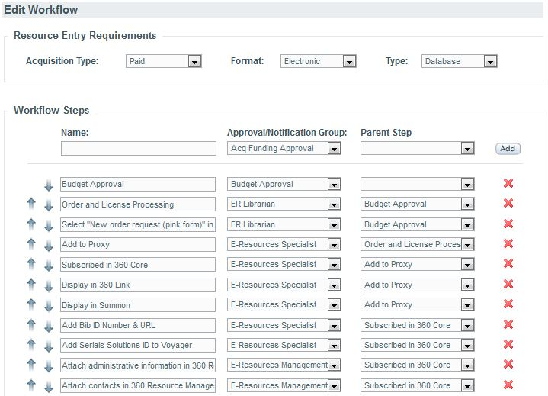

Slide 12
Hiring and onboarding Efficiently
- Keep job descriptions up to date
- Involve departing staff (and get them to leave a forwarding address)
- Familiarize yourself with HR personnel and hiring policies
- Put all of that documentation and cross-training to good use
        - Manuals
        - Checklists
        - Video tutorials
- Advocate for ERM staffing; the work isn’t going away

Slide 13
Questions?
Michael Fernandez
fernm@American.edu

